Slide 1

Winning Public Sector Contracts
Date: 29th April 2015
Location: Dunraven Arms Hotel, Adare
Speaker: Noreen Enright, Procurement Officer,
Limerick City & County Council

Slide 2
Outline
Why work with the public sector?
How is public procurement structured?
What are the thresholds?
What opportunities are there in 2015?
Where are tenders advertised?
How are tenders received evaluated?
What supports are available for small businesses?

Slide 3
Why work with the public sector?

Slide 4
Did you know?
The public service will spend around €8.5 billion on goods & services every year
    that's roughly €23.5m every day
In 2014 local authorities spent approx. €4.17 billion on goods and services
This doesn’t include capital expenditure

Slide 5
Organising The Public Service
Multiple public bodies buying similar goods and services
Speak with ‘One Voice’
Value for Money for the tax payer
Establishment of the Office of Government Procurement
All public service procurement

Slide 6

OGP Led Categories
Sector Led Categories
Professional Services
Facilities Management and Maintenance
Utilities
ICT and Office Equipment
Marketing, Print and Stationery
Travel and HR Services
Fleet and Plant
Managed Services
Local Government
  Minor Building Works & Civils
  Plant Hire
Health
  Medical Professional Services
  Medical and Diagnostic Equipment and Supplies
  Medical, Surgical and Pharmaceutical Supplies
Defence
  Defence and Security
Education
  Veterinary and Agriculture
  Laboratory, Diagnostics and Equipment

Slide 7
Advantages of winning a public sector contract:
Income stream
Continuous demand
Prompt payment
Local/regional
Source: Are tenders on your Radar?

Slide 8
How is public procurement structured?
Procurement refers to the buying of all goods, services and works by the public sector

Slide 9
Principles guiding Public Procurement
Non-discrimination
Equal treatment of tenderers
Transparency
Proportionality
Mutual Recognition

Slide 10
Legal Background
European Treaties
European Directives
National Rules & Guidelines
Common Law
Local Guidelines & Circulars

Slide 11
New Directives
Already A Government Policy
Not yet law – but policy
Aimed at supporting SMEs
  Smaller lots
  Consortium or joint bids
  Greater use of open tendering
  Reduced turnover requirements
  Support innovation

Slide 12
Thresholds
Less than €25,000:
  3-5 Quotations requested
  Subject to local guidelines
€25,000 + to the EU Thresholds (€50,000 for Works)
  Advertise on eTenders
EU thresholds
  Advertise in EU Journal via eTenders
  >€207,000 supplies & services
  >€5,186,000 works

Slide 13
What is a Framework?
An arrangement with suppliers
Supply goods, services and works
Agreed conditions
Specified period of time – max. 4 years
Single supplier framework
Multiple supplier framework

Slide 14
Tendering Procedures
Open
  Single stage procedure
Restricted
  Two stage process
  Those who meet minimum requirements invited to tender.
  Minimum Number Invited to Tender (5)
Competitive Dialogue – Very Rare
  Very complex requirements/specialist
  Provides more flexibility in the process
Negotiated – Very Rare
  RFT issued and responses form basis of negotiation

Slide 15
Opportunities in 2015

Slide 16
OGP Pipeline
Category | Q1 | Q2 | Q3 | Q4
Professional Services | Architectural Services (Local Government) | Financial & Economic Consultancy Services | Solicitors (Local Government) Legal Services (ETBs) Advisory Consultancy Services | Architectural, Quantity Surveying and Engineering Services Solicitors Advisory Consultancy Services
Facilities Management | Uniforms | Cleaning Products & Equipment Catering Security Services Uniforms Footwear | Cleaning Products & Services Waste Pest Control Standard PPE | Cleaning Products Laundry Services Waste Document Management Lift Maintenance Fire Alarm Services Boiler Maintenance

Slide 17
OGP Pipeline Continued
Category | Q1 | Q2 | Q3 | Q4
Utilities | Electricity Natural Gas Gas Mini Competition | Electricity Mini Competition Gas Mini Competition | Energy Advisory Contract Electricity Mini Competition Gas Mini Competition | Electricity Mini Competition Electricity Mini Competition Gas Mini Competition Fuels Advisor
ICT | ICT Research Advisory CRM | Application Licencing Solutions ERP Solutions Telecoms (Lease Line) Wide Area Network VOIP Network Equipment | Enterprise Virtualisation Mailroom Equipment Enterprise Backup Local Area networks PCs, Notebooks, Tablets, Thin Clients ICT Professional Services | Desktop Software Security monitoring and analysis software Mobile Services Computer Peripherals

Slide 18
OGP Pipeline Continued
Category | Q1 | Q2 | Q3 | Q4
Marketing, Print & Stationery | Polling Information Cards | Beef Certificates Print Shared Services | Promotional Events Framework General Print Framework Advertising Media Buying Framework | Envelope Contract Secure Print Frameworks Advertising Creative Media Frameworks
Travel, Transport & HR Services | Taxis (Dublin) Towing Services Garda FOI Training | Travel Insurance | Towing Services Employee Assistance Services Health & Safety Training | Courier / Pouched Mail Cash in Transit Car Hire Staff Learning & Development Selected Bus Services
Fleet & Plant |  |  | New Fleet Framework | Plant Framework
Managed Services | Shuttle Bus HSE Galway | Translation & Interpretation Services |  | Business Support Services

Slide 19
Local Government Pipeline
Q1 | Q2 | Q3 | Q4
Fuels (LA) | Energy Retrofit (LA) | Asbestos (LA) | Bitumen 2016 (LA)
 | Deep Energy Retrofit (LA) | Asbestos (OPW) | Plant Hire 2016 (LA)
 | Voids (LA) | Asbestos (Dept. of Education) | Building Works (HSE Non Acute)
 | Plumbing Services (LA) | Temporary Accommodation (LA) | Building Works (HSE - Acute)
 | Electricial Services (LA) | Building Refurbishment (OPW) | Mechanical Services (HSE - Acute)
 | Asbestos (HSE) | Pavement Management Survey (LA) | Mechanical Services (HSE - Non Acute)
 | Temporary Accomodation (Dept. of Education) |  | Electrical Services (HSE - Acute)
 |  |  | Electrical Services (HSE -Non Acute)

Slide 20
Limerick City & County Council Upcoming Tenders
Psychometric Tests
Staff Development Training Programme
Bridge Repair Works
Non-national road pavement overlays
Rhebogue Neighbourhood Greenway
Route 2 Shannon Fields Phase II
N21 Adare, N21 Ballinlyny and N21 Ballymurragh East Pavement Overlay
Munster Bridge Rehabilitations 2015 Contract No 1
VirusScan Tender
ICT Network Equipment
Wireless Access Points
Core HR Clocks
Feasibility study for Running Track
Security Services
Service Concessions for restaurants at Council Buildings and Pery Square Art Gallery

Slide 21
Where are tenders advertised?

Slide 22
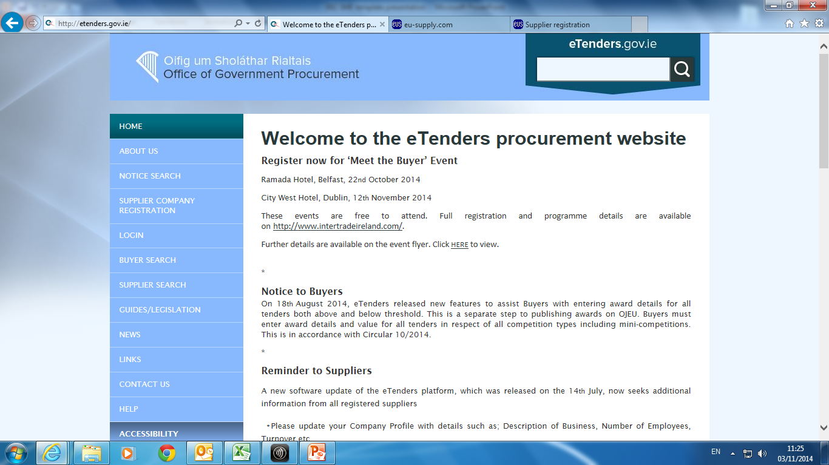
Where are tenders advertised?
www.etenders.gov.ie

Slide 23

Where are tenders advertised?
www.laquotes.ie

Slide 24
The Process – Should You Tender?

Slide 25
Tips for Responding to Tenders
Read the request for tender carefully
Decide if the tender is suitable for your company
Answer all the questions
Pay attention to the weightings attached to the selection & award criteria
Include all the required documentation
Submit your application by the closing date

Slide 26

Evaluation Process
Award
Selection
Compliance

Slide 27
Evaluation Process - Compliance
Tenders are checked to ensure they have complied with the instructions given in the ITT
Missing documents, blank documents, unsigned documents etc.
Clarifications

Slide 28
Evaluation Process - Selection
The selection criteria permitted are:
    Economic and financial standing
    Professional and technical knowledge or ability
    Quality assurance standards
    Environmental management standards
    Objective non-discriminatory short-listing criteria
Only tenderers qualified in accordance with selection criteria will proceed to be evaluated under award criteria

Slide 29
Evaluation Process - Award
Lowest Price or MEAT
MEAT - Most Economically Advantageous Tender
      Price
      Quality
      Technical merit
      Environmental characteristic
      Service & technical assistance
      Delivery terms
Weighting criteria for MEAT must be clear

Slide 30
What’s a Standstill Period
The standstill notice must give sufficient information to enable an unsuccessful bidder to decide whether there are grounds for seeking a review
Standstill Period (OJEU contracts)
      14 calendar days – standstill notice sent by fax or email
      16 calendar days – standstill notice sent by other means
      Standstill period commences day following publication of a valid standstill notice to unsuccessful Tenderers
During the Standstill Period
      Contracts Cannot be Concluded
      The Contracting Authority Cannot Negotiate Contract Terms
      The Contracting Authority Cannot Allow Work to Commence

Slide 31
Unsuccessful – Feedback is Available
Available on request
  Reasons for elimination
  The name of the successful tenderer
Not entitled to details of others tenders (including prices)
Notices of Contract Awards

Slide 32
Social Benefit Policy
The Council will “promote social benefits in public procurement”
Promote equal opportunity and provide opportunity for social returns to the community to be acknowledged in the scoring frameworks / criteria and assessment of tenders
Aimed at addressing long-term & youth unemployment
In line with EU Law & National Law

Slide 33
What Supports are Available to small business?

Slide 34
Support
Additional support and training available:
  Local Enterprise Office
  Enterprise Ireland
  Intertrade Ireland

Slide 35
Tender Advisory Service
Operational from 1st February, 2015
Objective – Support SMEs
  Outlet to raise concerns in relation to a live tender process
Contact www.procurement.ie or tenderadvisoryservice@ogp.ie

Slide 36

Best of Luck!

