Slide 2
Digital in 2016

Slide 3
Keep asking, how does this help my business?

Slide 5
The Past

Slide 6
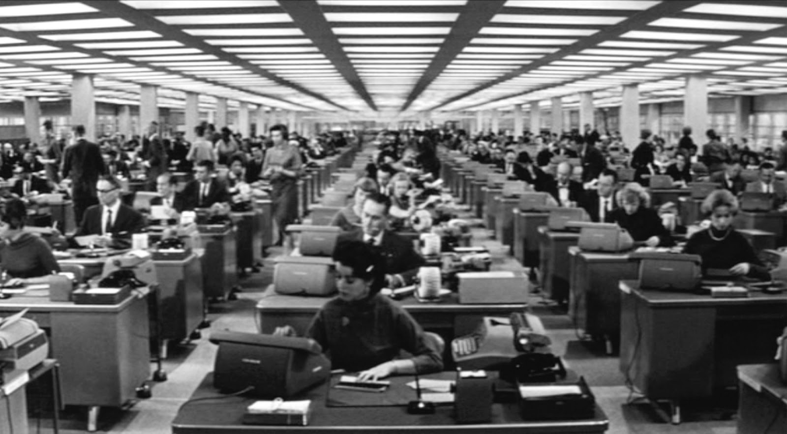

Slide 7
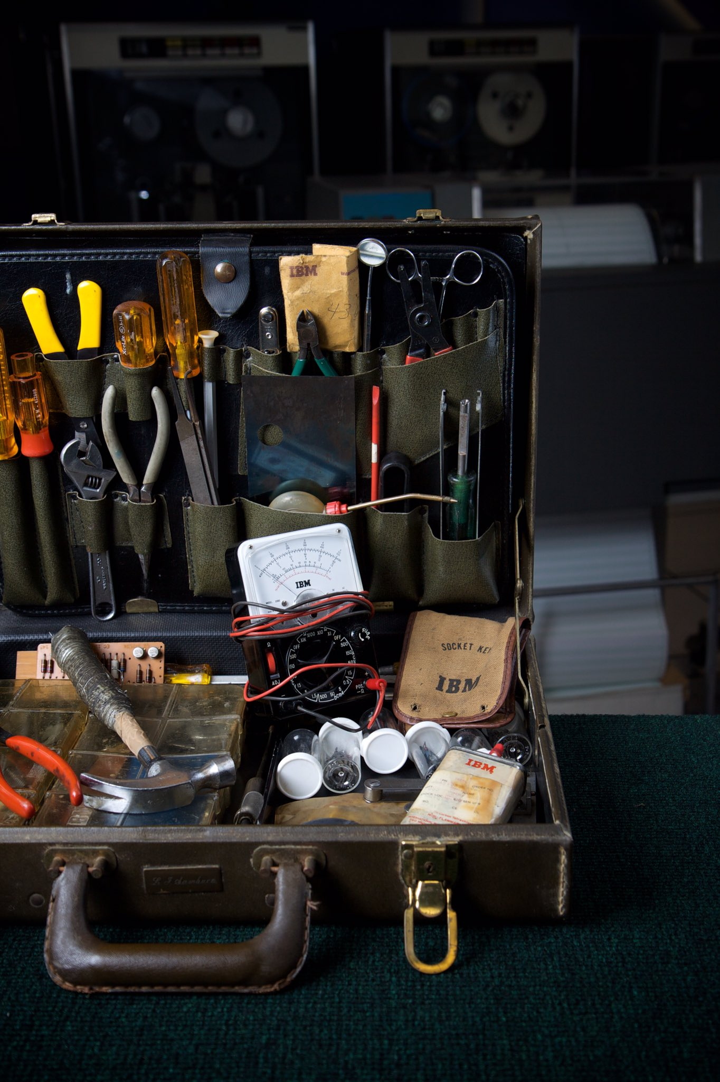

Slide 8
The Present

Slide 9
“Everyone has their nose stuck in a …”

Slide 10
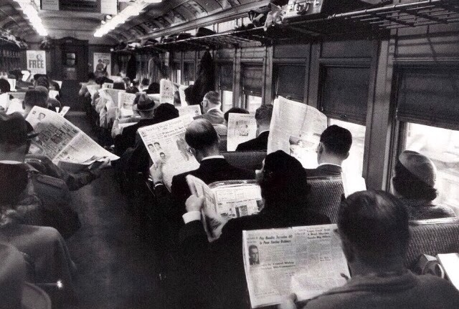

Slide 11
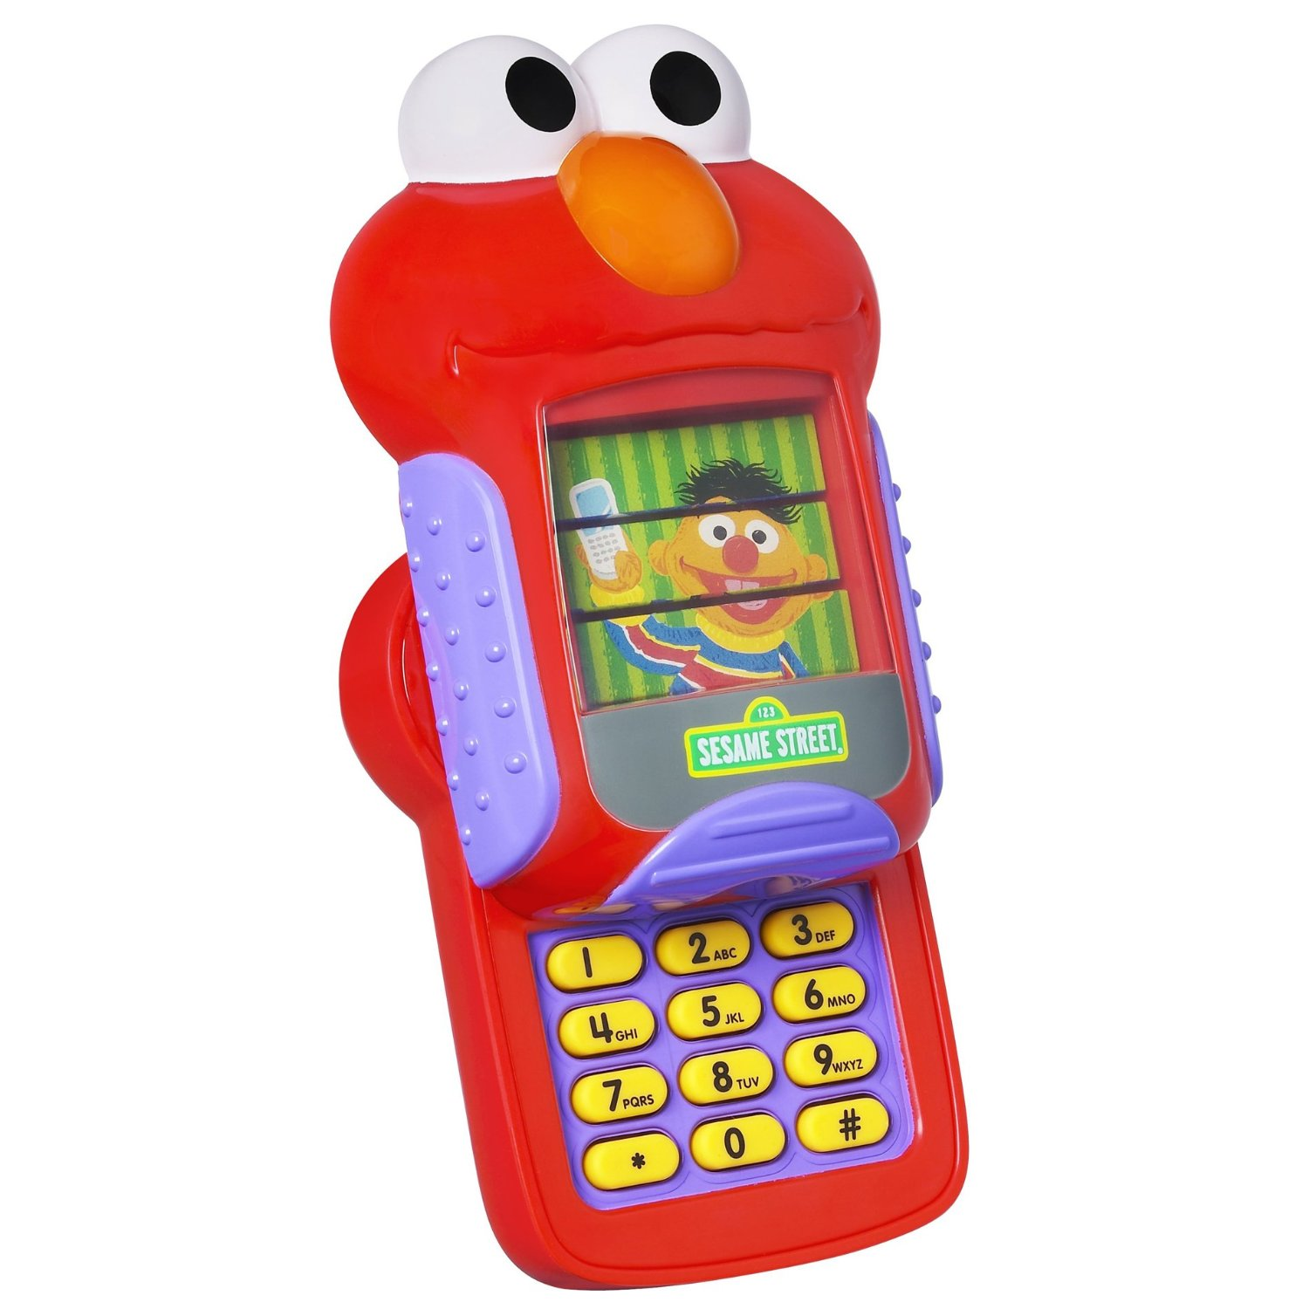

Slide 12
Mostly Mobile Media

Slide 13
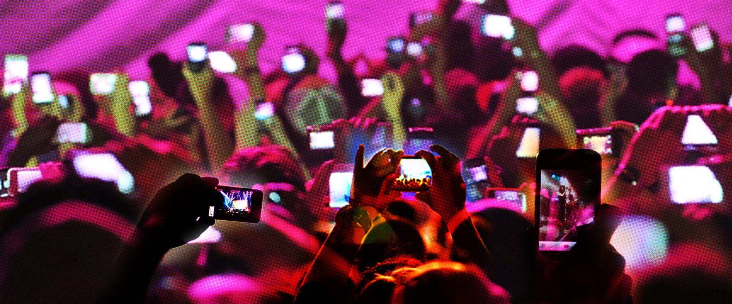

Slide 14
50% of all Google search is mobile.

Slide 15
88% of smartphone Internet time spent in apps, 12% via browser
- ComScore UK

Slide 16
1 Billion YouTube users per month

Slide 17
40 mins = Average YouTube session time on Mobile

Slide 18
How does this help my business?

Slide 19
Your target market is on social media mostly via mobile

Slide 20
Your target market reads your emails on a mobile

Slide 21
Google Today: Mobile optimised, fast loading, no pop-ups

Slide 22
and

Slide 23
3 Billion Google searches daily, 1 Trillion yearly

Slide 24
Google is for answers, social media is for?

Slide 25
Facebook has 1.71 Billion users worldwide

Slide 26
1 Billion access with phone or tablet ONLY

Slide 27
Facebook has 1.13 Billion daily users

Slide 28
2.8 Million in Ireland and still growing

Slide 29
2 Million Daily

Slide 30
8 billion video views worldwide

Slide 31
Daily and 75% of them are mobile

Slide 32
53 percent of all video views come from shares.
Every day more than 500 million people watch video on Facebook.
People now watch a collective 100 million hours of video.
Facebook user watches 12 full minutes of video. Huge potential.

Slide 33
313 Million people using Twitter per month

Slide 34
There are 750,000 Irish people using Twitter

Slide 35
30% log into Twitter Daily in Ireland

Slide 36
2 Million Tweets per day in Ireland

Slide 37
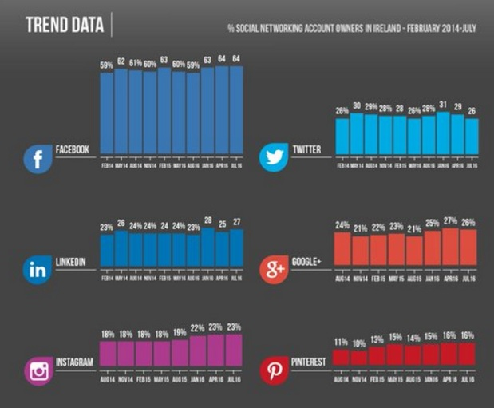

Slide 38
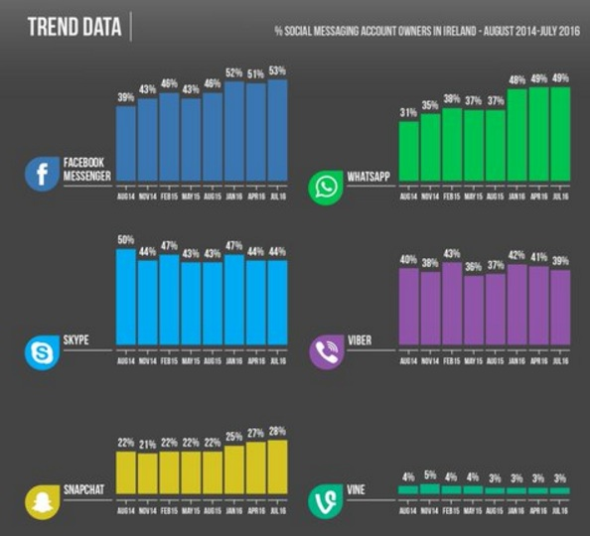

Slide 39
72% of FB a/c owners use it daily
vs.
39% of Twitter a/c owners.

Slide 40
Instagram has 500M monthly users, 300M daily

Slide 41
860k Instagram users in Ireland

Slide 42
Instagram: 340k men 520k women (60% female) 590k are 30 and under, 36k are 50+

Slide 43
Instagram is bigger than Twitter now

Slide 44
Snapchat uploads more photos per day than Facebook

Slide 45
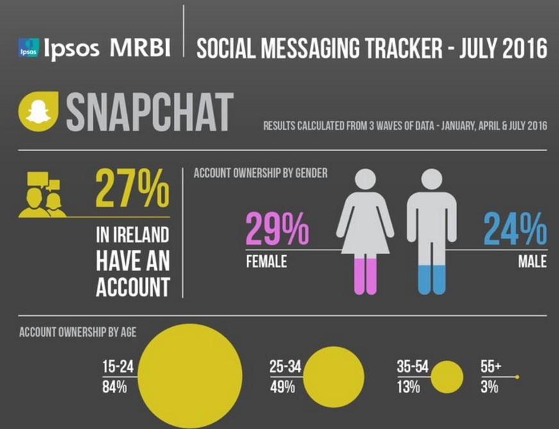

Slide 46
More people use Snapchat than Twitter Daily in Ireland

Slide 47
Facebook is 12+, Snapchat is about 4 years old

Slide 48
Snapchat:
84% of 15-18 year olds have an account. 85% of these 15-18 year olds use it daily.

Slide 49
How does this help my business?

Slide 50
Whatsapp: 1 Billion users a month

Slide 51
Whatsapp sends more messages than ALL mobile companies

Slide 52
Facebook Messenger 1 Billion users a month

Slide 53
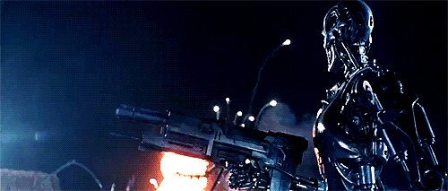
The slides where I start to freak you out

Slide 54
Buzzwords

Slide 55
A.I.

Slide 56
Autonomous

Slide 57
V.R./A.R.

Slide 58
IoT – Internet of Things

Slide 59
مرحبا الجيران

Slide 61
Google Translate gets better every time it’s used

Slide 62
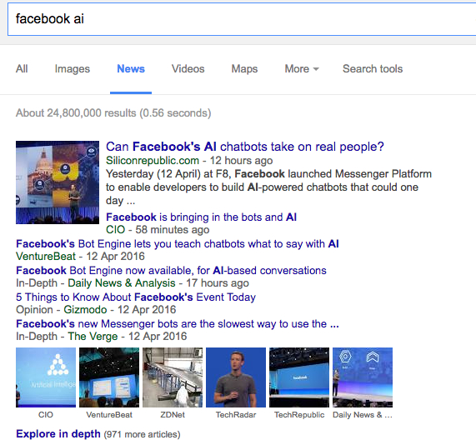

Slide 63
AI powered Facebook chatbots answer you

Slide 64
Facebook M is Siri for Facebook

Slide 65
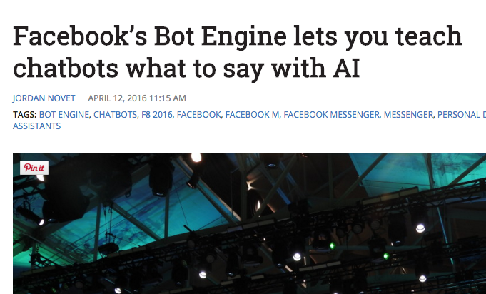

Slide 66
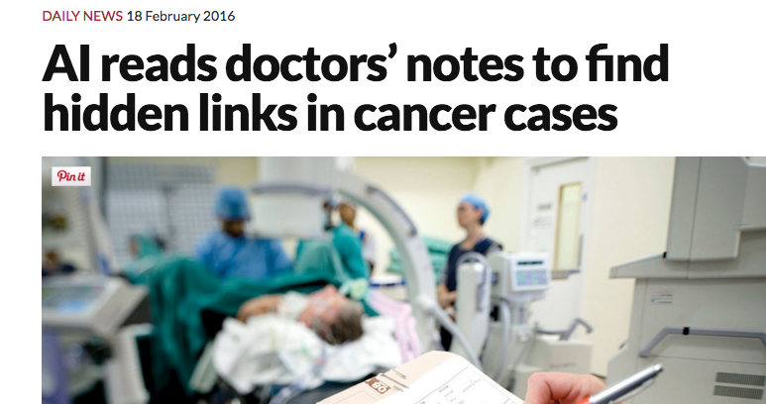

Slide 67
Autonomous

Slide 68
Remote Everything

Slide 69
Brain surgery

Slide 70
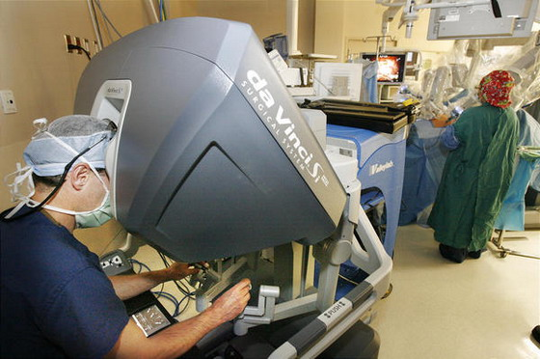

Slide 71
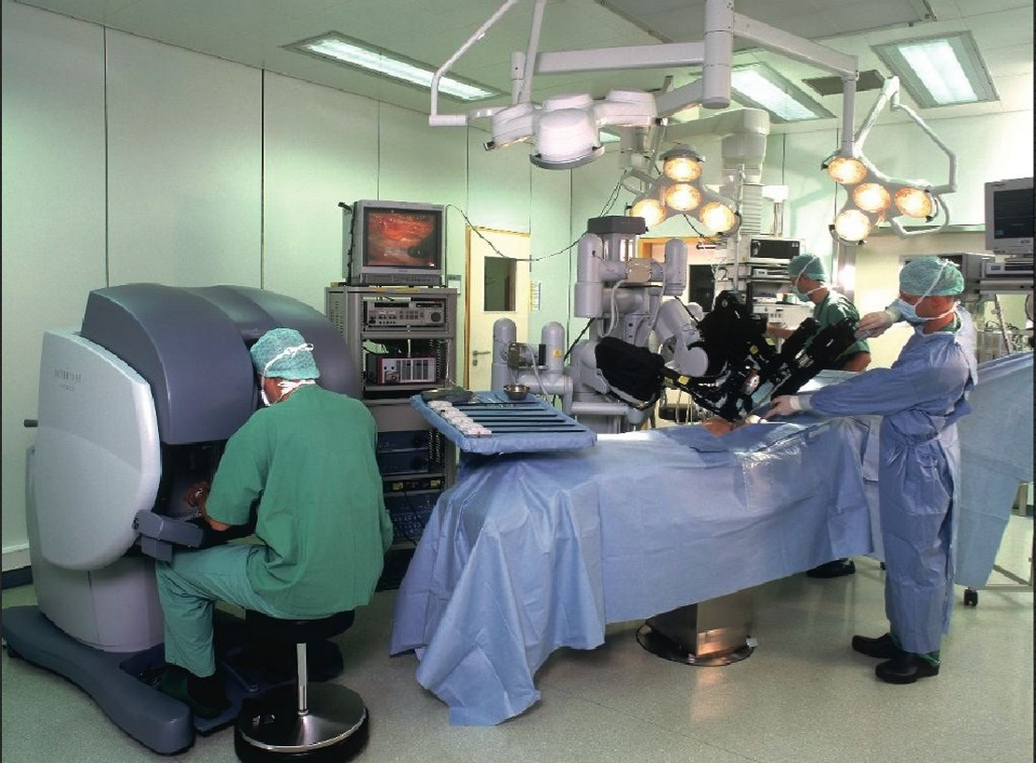

Slide 72
Remote Flying

Slide 73
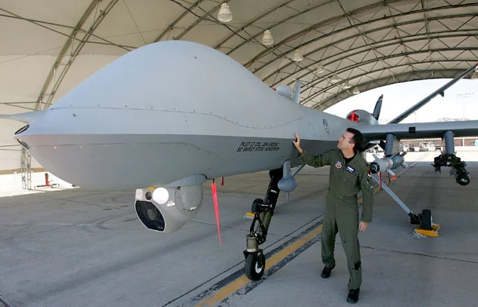

Slide 74
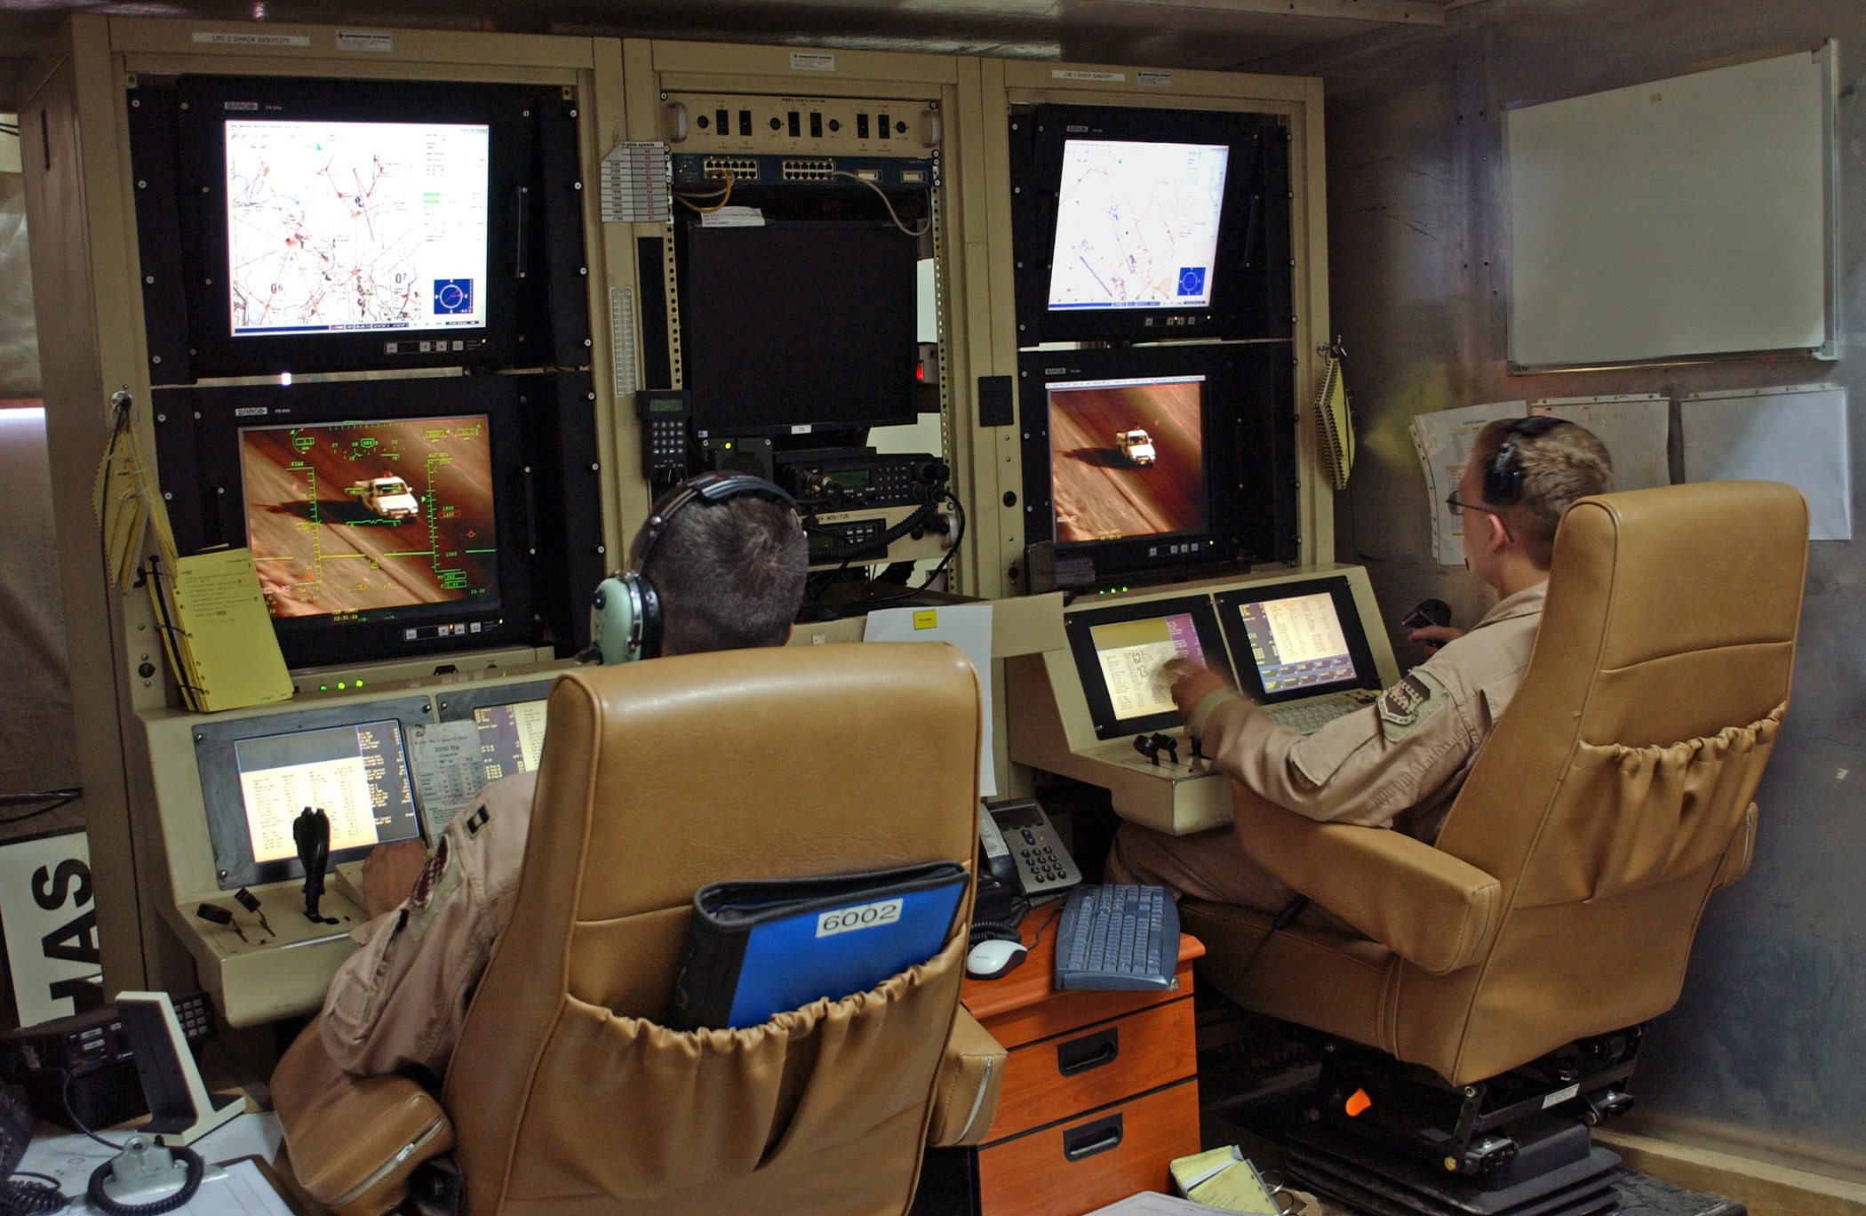

Slide 75
Autonomous …

Slide 76
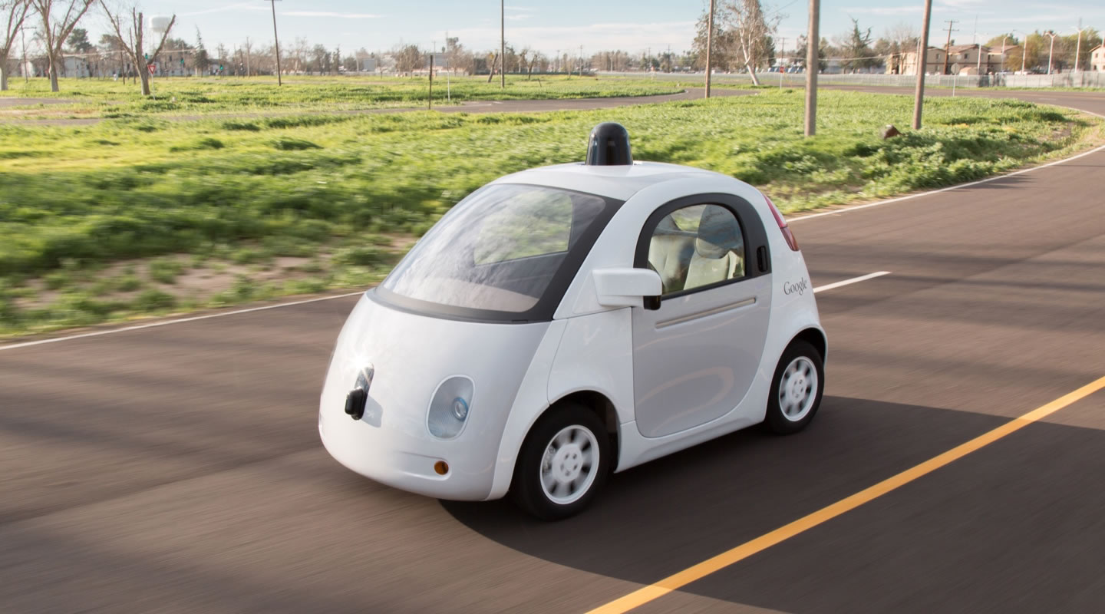

Slide 77
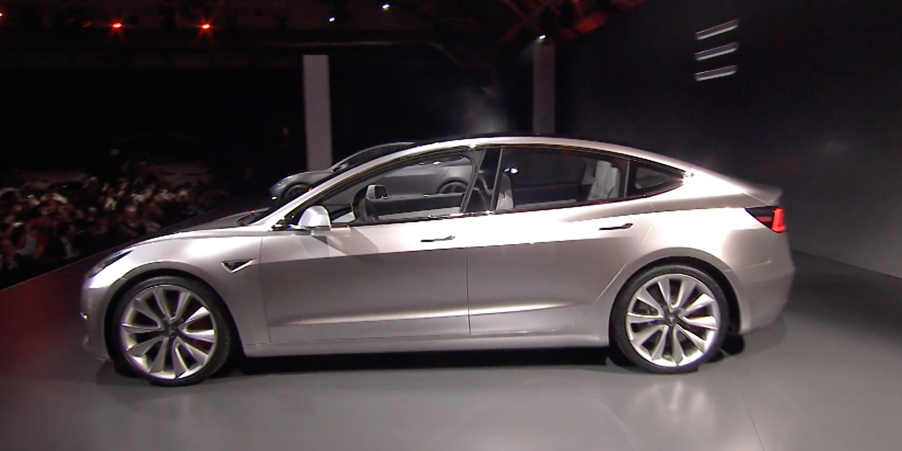

Slide 78
400k pre-orders

Slide 79
What can you do to streets when no parking needed?
What about car parks in cities?
Can you rent your car out when you’re at work?
Do you need a car?

Slide 80
V.R./A.R.

Slide 81
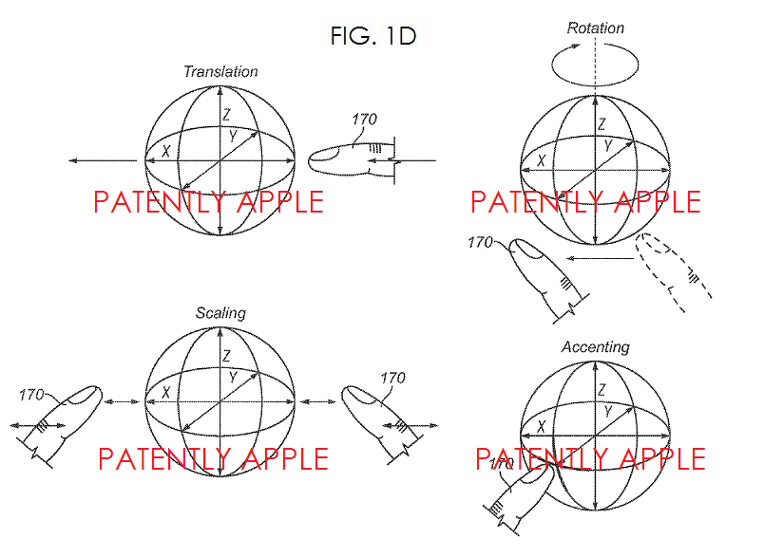

Slide 82
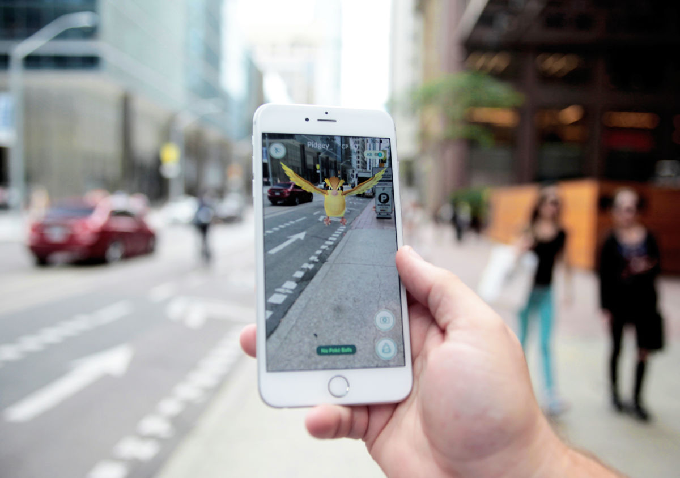

Slide 84
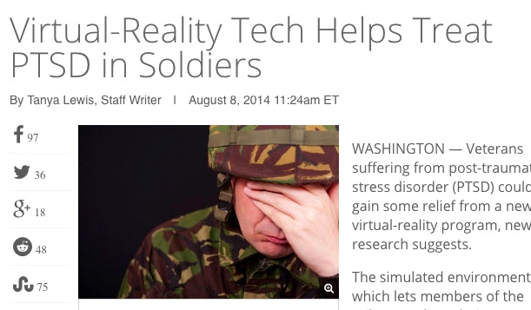

Slide 85
How does this help my business?

Slide 86
IoT – Internet of Things

Slide 87
Moore’s Law is changing

Slide 88
Chips will be tiny, connected and disposable

Slide 89
You can rent computing power off Amazon

Slide 90
And make Toy Story cheaper than they did!

Slide 91
What can you do when chips are eveywhere?

Slide 92
Questions?

