Slide 1
Intellectual Property
David Hyde
Information Centre
Patents Office
Local Enterprise Office, Sligo
8th March 2016

Slide 2


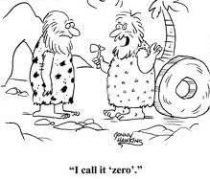

What is Intellectual Property
A company’s intangible assets –
  Brands
  Inventions
  Designs
  Human capital and know-how
Often more valuable than a company’s physical assets

Slide 3
Types of Intellectual Property ?
Automatic:
      Essentially free to enjoy, but may be tricky to enforce
  Copyright – Artistic works, text, graphics . . .
  Trade Secrets - Confidentiality
  Know How – Commercial advantage
Registrable:
      harder/more expensive to get, but easier to enforce
  Patents – Invention, function, process
  Trademarks – Name, logo, slogan
  Registered Designs – Appearance, shape & configuration

Slide 4

Why is IP useful?
Your IP:
Adds to balance sheet of a company – potentially increase value if selling on.
Facilitates licensing revenue
Use as security for borrowing
Marketing (“our newly patented technology..”)
Knowing about IP:
Don’t miss opportunities: Allows you to secure protection before the chance is lost
Early warning: Allows you to identify possible infringement problems early on (someone else infringing your IP, or you infringing someone else’s). Enough time to prepare a strategy

Slide 5
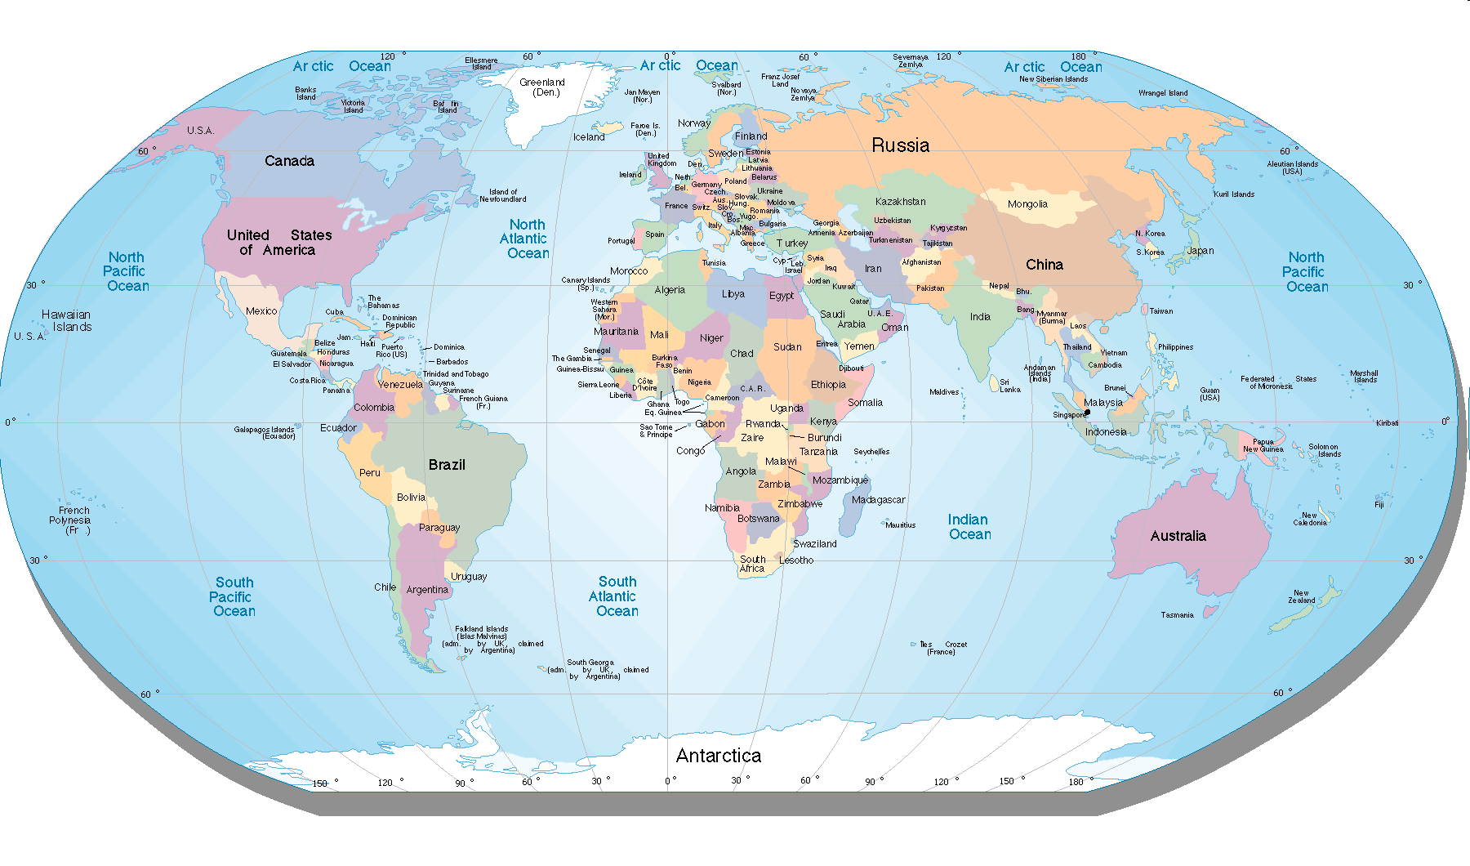
IP Rights are Territorial

Slide 6
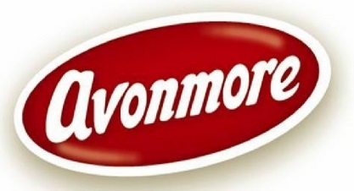










Trade marks
“Any sign capable of being represented graphically… which is capable of distinguishing the goods or services of one undertaking from those of other undertakings”

Slide 7





Trade marks (continued)
Must be registered – nationally or at EU
    then allowed to use “®”
    “TM” is not an indication that the mark is registered. These marks not protected by trademark law (but may be other legal considerations)
Absolute monopoly – strongest protection
    prevent others from using, without preconditions
Can be kept alive indefinitely
Requirements:
    Must be distinctive,
    can’t be descriptive
    Only for designated goods/services

Slide 8
Nice Classification
45 classes of goods (34) and services (11)
Class 5 - Pharmaceutical and veterinary etc.
Class 12 - Vehicles; apparatus for locomotion by land, air or water.
Class 15 - Musical instruments.
Class 25 - Clothing; footwear; headgear.
Class 35 - Retail; advertising; auctioneering.
Class 38 - Telecommunications services.

Slide 9


Trade marks - first steps
Search Trade Mark Databases
  Searching is free of charge
  National and/or Community databases (OHIM) & WIPO
TMView – www.tmdn.org
  contains national trade mark data from 40 countries, plus OHIM & WIPO giving access to 25.9 million trade marks.
  Check for the availability of your trade mark name

Slide 10

The Application process
File Application - nationally
Renewed every
10 years
Searched
Examined
Accepted
Opposition – 3 months
- - - - - - - - - - - 6 months - - - - - - - - - - - -
Establish priority date
File CTM or International

Slide 11
Statutory Trade Mark Fees
Registration in Ireland | Community Trade Mark
Application Fee per class €70 Registration Fee €177 | Application and €900* Registration Fee
Total for application with 3 classes = €387 | Total cost for application with 3 Classes = €900*
Renewal Fee 1 class €250 for each additional class €125 | Renewal Fees (3 classes) €1350* additional class over 3 €400* *(Fees are based on electronic-filing/payment).

Slide 12
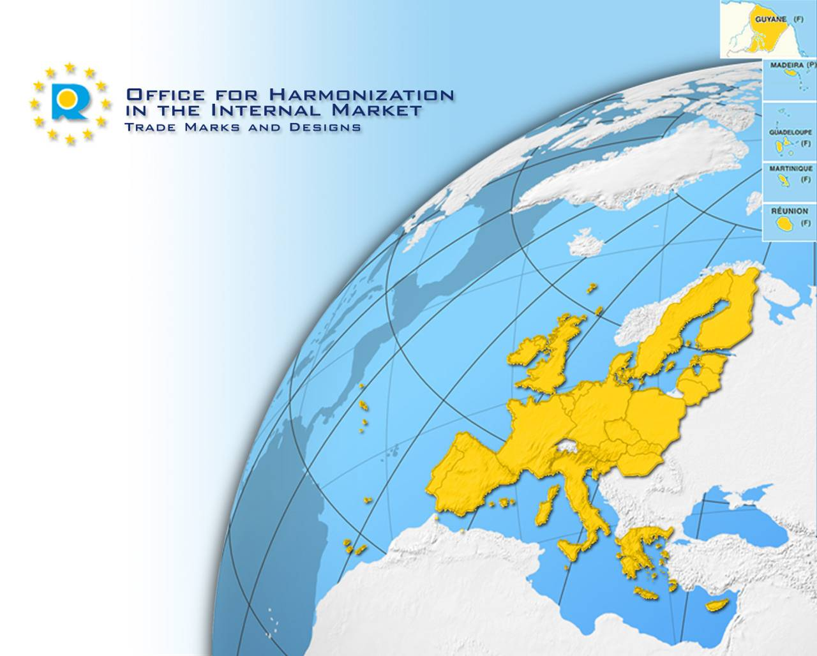
Community Trade Mark
Unitary protection
Mark valid in all EU Member States
Single application
- European Union trade mark
www.oami.eu.int
European Union Intellectual Property Office (EUIPO)

Slide 13
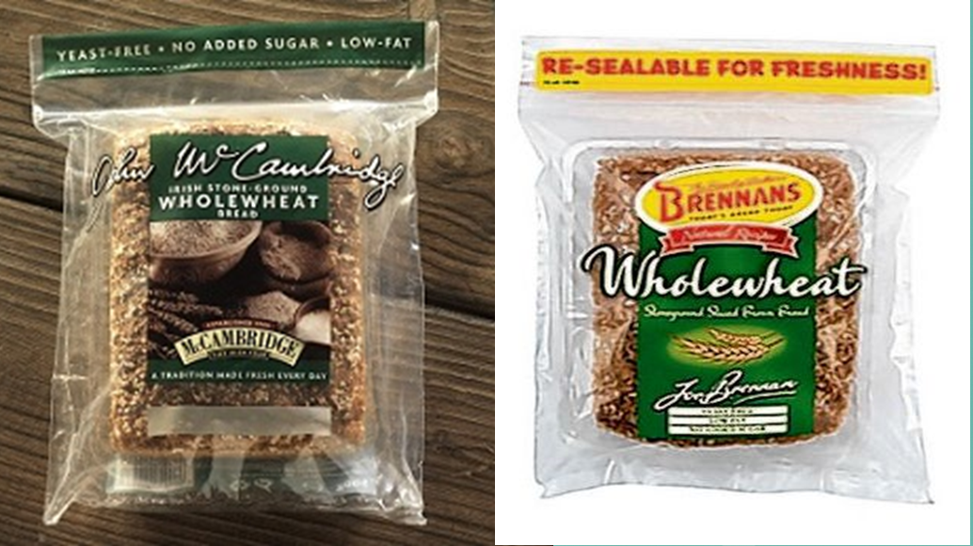
Trade mark – case study

Slide 14
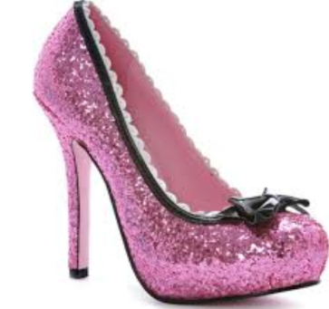
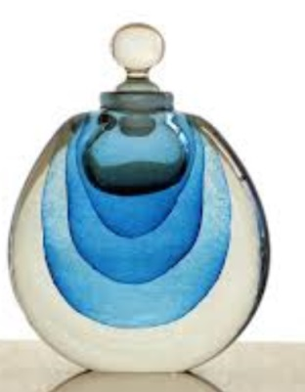
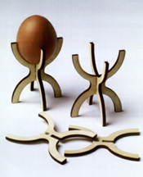
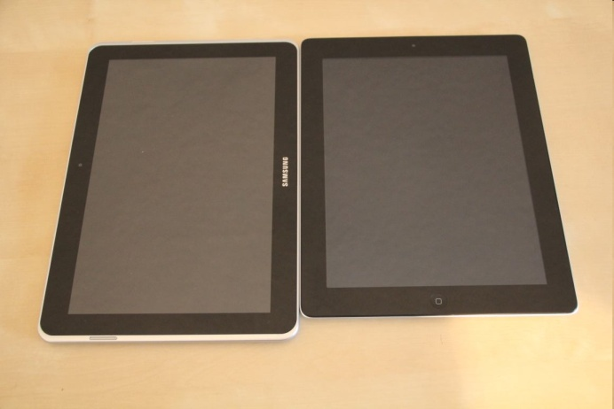
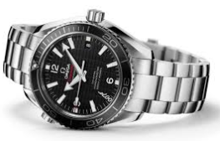
Designs
The overall look of the product resulting from the ...
  Lines
  Colours
  Textures
  Contours
  Materials
  Ornamentation
  (not the function)
www.newgadgets.de

Slide 15
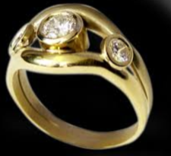
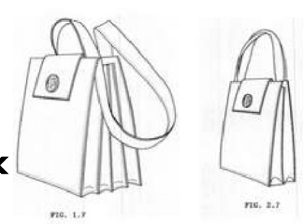



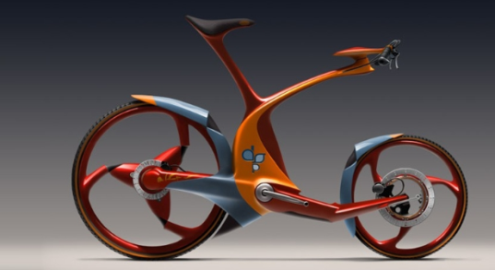
The First Step
Consider your Market
Search Registered Design Databases
  National - www.patentsoffice.ie
  Community databases – www.tmdn.org (OHIM)
oami.europa.eu

Slide 16
The Application Process
Application form
Filing receipt
Formalities check
Acceptance/registration
Publication/deferred publication (up to 30 months)
Can take up to 4 months from date of filing of application to registration

Slide 17
Statutory Design Fees
Fee | Ireland | Community Design (RCD)
Application/ registration Fee | €70 | €230
Publication Fee | None | €120
Deferment Fee | €35 for up to 30 months | €40
Renewal Fees | 2nd period of 5 years = €50 3rd period of 5 years = €70 4th period of 5 years = €80 5th Period of 5 years =€100 | 2nd period of 5 years = €90 3rd period of 5 years = €120 4th period of 5 years = €150 5th Period of 5 years =€180

Slide 18
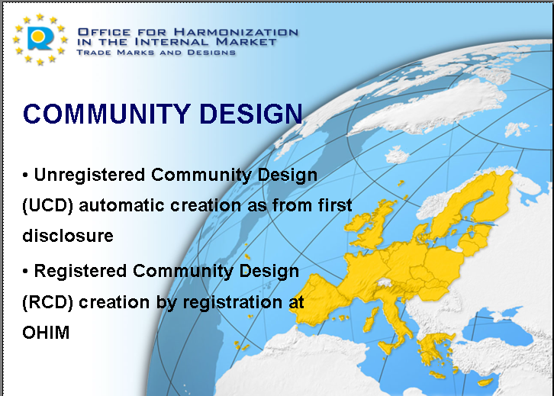
European Union Intellectual Property Office (EUIPO)

Slide 19

Patents
“A Government grant of the exclusive right to make, use, or sell an invention, usually for a limited period” Encyclopaedia Britannica
Protects a fundamental idea – an “invention”
- it protects function rather than form
- does not exist automatically ! !

Slide 20



Patent - Protection in Ireland
Via Irish Patents Office
Via European Patent Office (EPO)
(38 Contracting States to EPC)
Via (WIPO) Patent Co operation treaty
(PCT) (148 Contracting States to PCT)

Slide 21
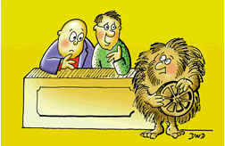
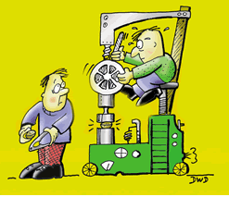

Patents – what qualifies?
New/Novel
Inventive step
Industrial applicability

Slide 22
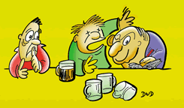

The First Step
Do not Disclose or Publish
Search for Novelty - Espacenet
Consider your Market & Product Life Cycle
Consider the Costs
The Decision to apply for a
  patent should be part of your Business Strategy.

Slide 23
What does a patent look like?
DESCRIPTION
The description of your patent application must give detailed disclosure as to what your invention is, what it does and how it works.
CLAIMS
The claims are the important section of your specification as the scope of the monopoly given by a patent is legally determined by the claims, not the description.
ABSTRACT
The abstract is a short summary (150 words or fewer) of your invention. This is primarily used for search purposes.
DRAWINGS
The drawings section of your application should represent pictorially the detailed depiction discussed in the description section.

Slide 24
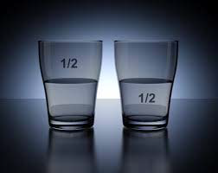
The Patent Specification
Optimist: “The glass is half full”
Pessimist: “The glass is half empty”
Patent attorney: “Liquid H20 bisects an open cylindrical vessel”

Slide 25
Statutory Irish Patent Fees
Fee | Short term 10 years | Long term 20 years
Application Fee | €60 | €125
Search Fee | None | €200
Grant Fee | €30 | €64
Renewal Fees vary each year | Year 3 = €30 Year 10 = €110 | Year 3 = €60 Year 20 = €468
Total | €659 | €5017

Slide 26
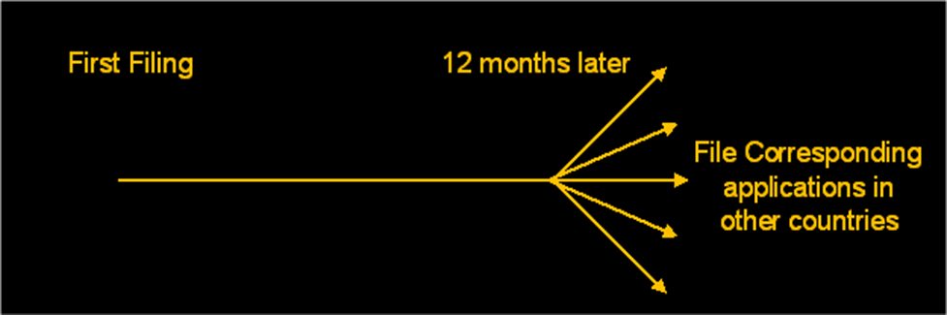
Patents - Application process

Slide 27
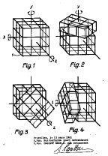
Patent case study - Erno Rubik.
First claim from Hungarian patent HU170062
Spatial logical toy as claimed in claim 1,
characterized in that in forming the cube (1),
a six-membered identical shape and size are
provided at each centre of the cube faces and
includes a prismatic projection (6) and a head
(5) machined from a single piece together with
the extension, these six elements are provided
with a covering surface and a square lower
limiting surface spherical.

Slide 28

What is Copyright
Copyright is a property right, given to authors/
creators of literary or artistic work such as music, songs, films, books, computer programmes, etc.
- Relates to the expression
of an idea, not the idea itself

Slide 29

Copyright Protection
There is no copyright registration system in Ireland.
Automatic right - the Author (original creator of the work) is the owner.
E.g. © Copyright Joe Blogs 2015
Protection not absolute: must prove copying has taken place (can sometimes be difficult)

Slide 30


Copyright and Business
Use of a TV or Radio in a public space must be paid for – royalties!

Slide 31
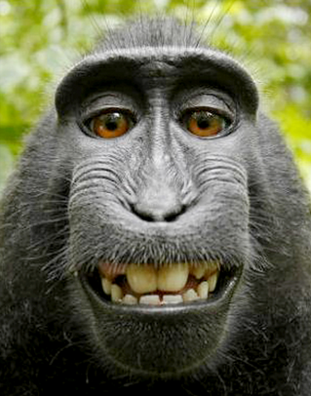
Copyright case study

Slide 32

Trade Secret
A trade secret is a formula, practice, process, instrument or compilation of information which is not generally known.
Can give its owner an actual or potential advantage in business, (e.g., formula for Coca Cola®)
Cost to acquire/maintain: None
Time to acquire: immediate
Duration of protection: perpetual
as long as secret is maintained.
Google’s algorithm is its version of a secret recipe: how it mixes the information of a website’s relevance, number of visits, inbound links, anchor tags, user’s location, and other factors, in order to provide the search results best tailored for each user.

Slide 33
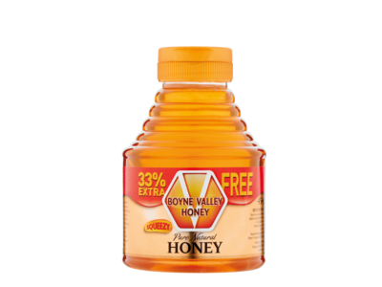
One product – many IP Rights
Trade marks
Company name, Logo
Product name
Designs
Overall form of the bottle
Arrangement and shape
Patents
Function of the cap
Trade secrets
Blend of honeys, know-how kept "in-house" and not published
Copyright
Text
Graphics

Slide 34




What should I do?
Ask yourself if you have IP or if you intend to use IP owned by others.
If your business is based on an invention, take care about disclosure or publication.
Look before you leap –undertake searches of patent, TM and design databases .
Consider your market.
Consider the life cycle of the product.
Consider the costs.
Reflect IP in business strategy and planning.

Slide 35



Services Available from
Patents Office website
IP Legislation & Official Journal
Access to FREE search facilities
Links to other National & International IP Offices – www.innovaccess.eu
List of IP Agents
IP Clinics

Slide 36
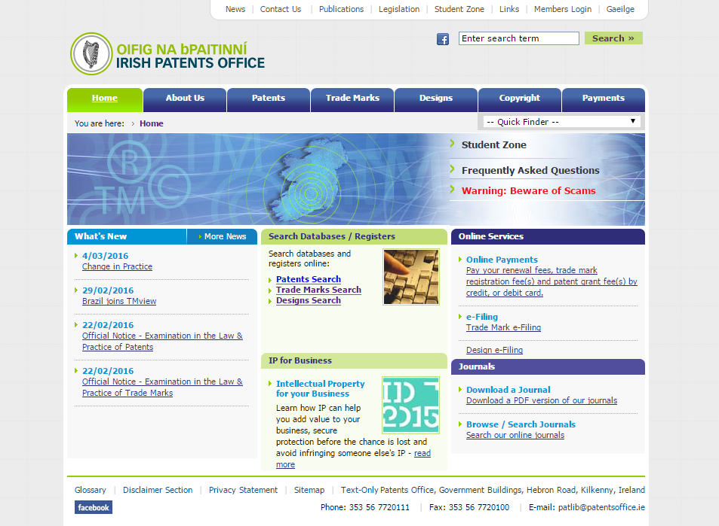
www.patentsoffice.ie

Slide 37
Contact Us
Website: www.patentsoffice.ie
Email: patlib@patentsoffice.ie
Phone: LoCall (1890) 220223
or (056) 7720111 (open from 9:30am to 5:00pm)
Thank you for listening
Questions or Comments?

