Slide 1


P.J. O’Reilly
Regional Manager
Enterprise Europe Network

Slide 2

Overview
Who we are?
  The world’s largest support network for SMEs with international ambitions.
How can we help?
  We combine international business expertise with local knowledge to help you take your innovation into new markets.
What is in it for you?
  Helping your business grow faster through tailored support, new commercial partnerships and access to finance.
An EU one-stop-shop to meet all the support & information needs
of Small & Medium Enterprises in Europe.
Part of the EU COSME Programme
Notes:
OVERVIEW: Read headings and expand.
SMEs in this instance can also mean an inventor. BUT the invention would need to be protected by something like a product or process patent, a design patent or copyright, whichever was relevant in an individual case.

Slide 3

Notes:
3
There is so much coming at you that it can be quite confusing.
So we will now try to assist you in navigating the right support for you.
Otherwise the men in white coats could be coming for you.
But it’s not easy to take advantage of these opportunities. There are many obstacles.
It’s not easy for small companies to:
navigate the maze of European and national legislation….
overcome language barriers to find new markets and partners abroad
recognise the innovation potential in their businesses and profit from their ideas
be able to find and secure European financing, grants and funding
Where can they turn?

Slide 4

Typical Issues
How do I find a new market abroad?
How do I get European funding?
I need a business partner in another country…
How can I sell my innovative
ideas and technology?
What does this EU law mean for my business?
Notes:
4
These are some of the typical questions/issues that you have to deal with in your own day to day business decisions.
Which markets / Business partners / IP Protection / EU Law.
We will cover them as we go further into the presentation.
We help with questions like these every day!
The Network provides information on EU legislation and funding, helps companies find business partners, especially in other countries, and offers advice on how to develop an innovative idea. The Network can also help to maximise your chances of success when you’re tendering for EU contracts or funding.
The Network has access to two powerful databases to help companies: one for business partnerships and one for technology transfer.
Company profiles and offers are inserted into the databases and are then made available to the whole Network. Partners use the databases to search for the right match for their clients and then help them to reach partnership or technology transfer agreements. The databases now contain around 7,000 profiles.
They are updated on a weekly basis and the technology and partnership offers are communicated to SMEs through newsletters, media advertising and websites.

Slide 5
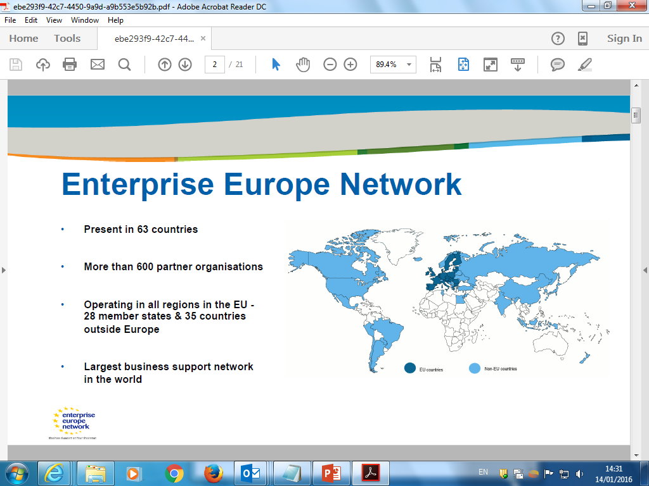


Global Reach
Enterprise Europe Network
Present in 60 countries
More than 600 partners organisations.
Operating in EU 28 member states and 32 other countries
Largest business support network in the world
Notes:
5
It started out as an EU Network, but in the meantime many global markets have realised the Network’s potential and joined up.
USA / Canada / Japan / China / Brazil / India to mention a few.

Slide 6
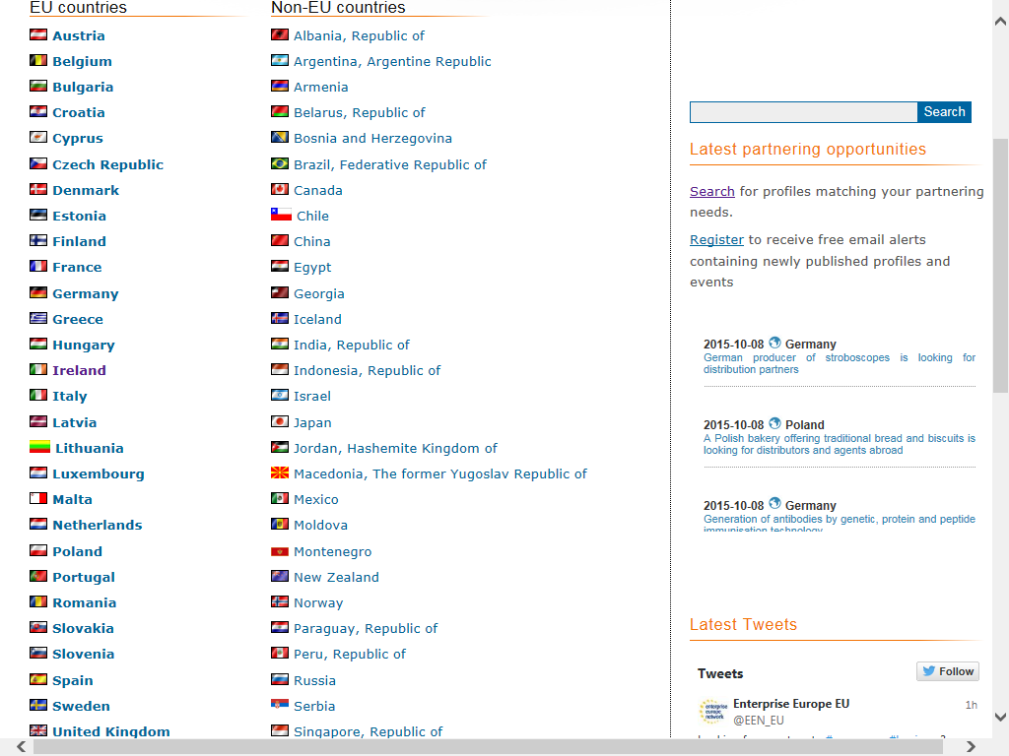
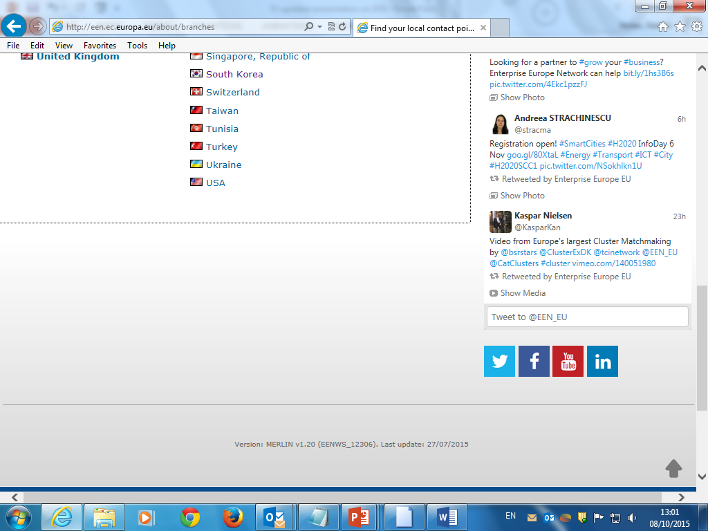

The EEN Network Reach
Notes:
If you really want to see all the members, you can access this information on our website.
If you can read all of this text from the slide, you get a prize.

Slide 7
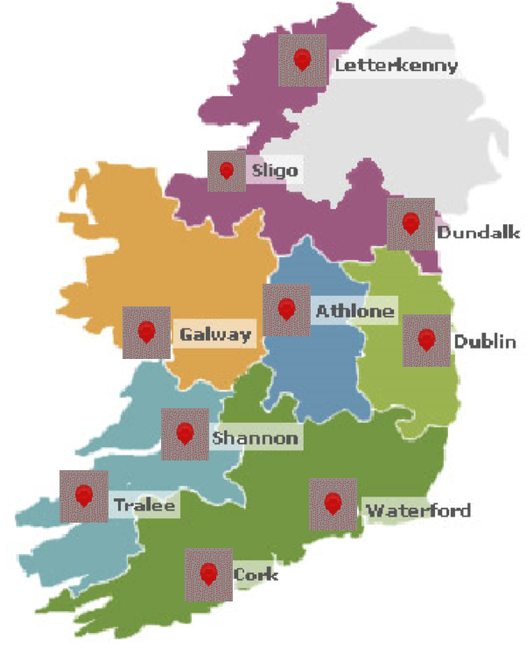
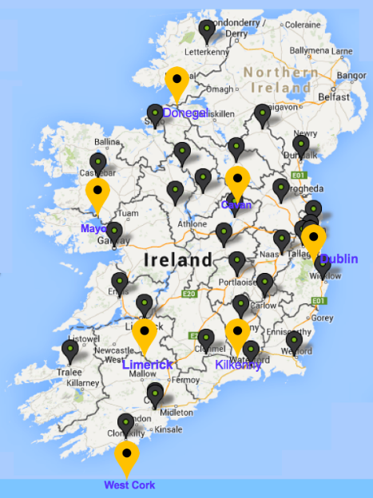
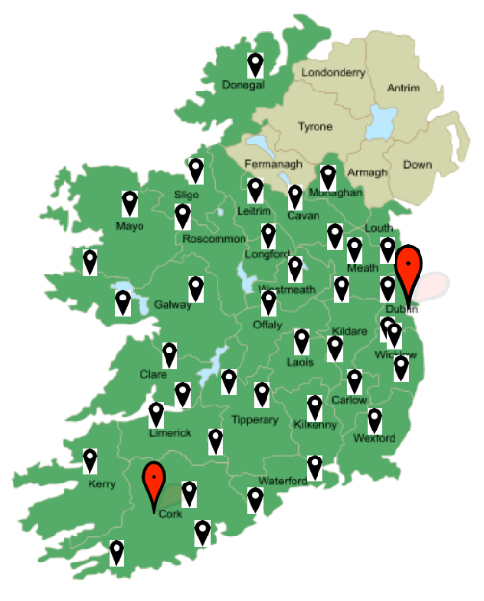

Enterprise Ireland Local Enterprise Offices Dublin Chamber &
Cork Chamber
The Enterprise Europe Network in Ireland
www.een-ireland.ie
Notes:
As you can see, the network now has a massive footprint on the SME landscape.
Enterprise Ireland Offices
Local Enterprise Offices
Chamber Offices, Primarily Dublin and Cork.

Slide 8
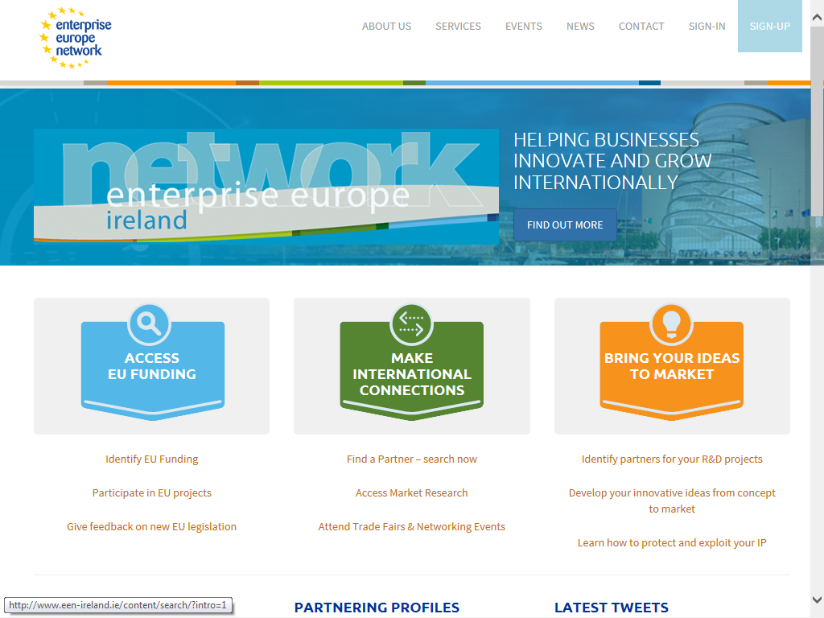
Our Services
www.een-ireland.ie
Notes:
8
Now we go into a little more detail on the types of services. ON THE NEXT FEW SLIDES

Slide 9
Our Services
Identify EU Funding – information on access to finance resources
Give feedback on new legislation -
SME Feedback is a spontaneous reporting of difficulties resulting from existing EU legislation or policies, experienced by SMEs
Participate in EU Projects – we can assist you in participating in EU funded research projects through Horizon 2020
www.een-ireland.ie
Notes:
9
We help to find sources of funding and information on EU projects.

Slide 10
Our Services
Find a Partner - Search Europe's largest database of business, technology and research opportunities www.een-ireland.ie
Access Market Research - 4,000 local experts in 60 countries to offer valuable market insights such as country profiles and local trade information.
Attend Networking Events & Trade Fairs - Awareness events on EU topics, EU funding and IPR. Brokerage/Matchmaking events and Company missions
www.een-ireland.ie
Notes:
10
Looking for technology and business partners in other markets.
Detailed market research through our local experts.
Give you access to many of the networking events at major trade fairs.
This will necessitate you putting a relevant profile together.
There is an EEN company profile template which helps give structure and clarity to your profile, be it TO, TR or Business related.

Slide 11
Our Services
Identify partners for your R&D projects - help you find a partner to join a consortium for a research project under a specific call to be funded by the EU
Develop your innovative ideas from concept to market - Horizon 2020 SME Instrument
Learn how to protect and exploit your IP - offer advice and access to the European IPR Helpdesk
www.een-ireland.ie
Notes:
11
Find opportunities for research projects.
Exploit your innovative ideas and products and or services in new markets.
Help to protect and maximise your IP potential.
Does this by finding the relevant partners for your business.

Slide 12
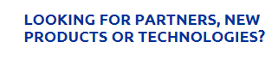
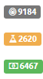
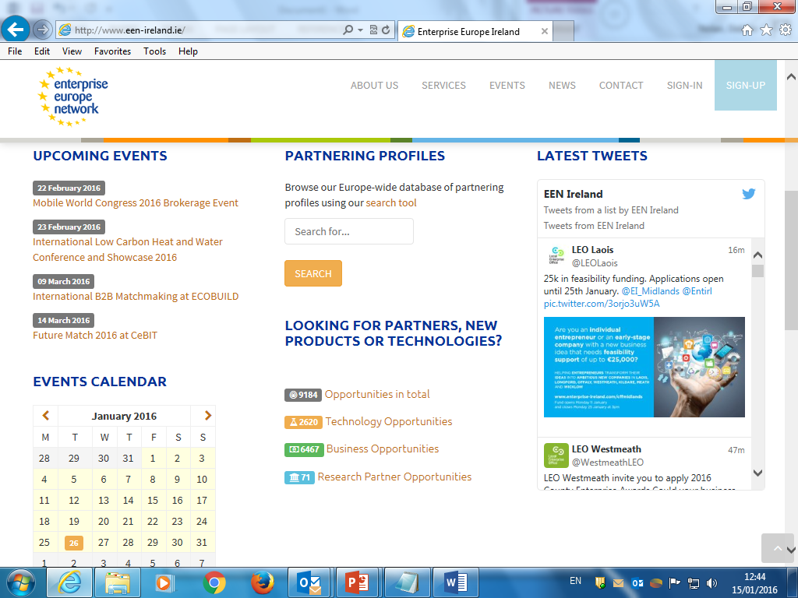
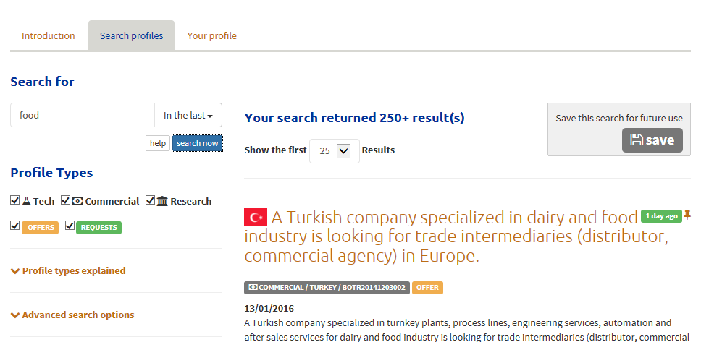
EEN Partnering Opportunities Database
Search our database
To find commercial partners
To find technology partners
To find R&D partners for EU funding proposals
Opportunities in total
Technology Opportunities
Business Opportunities
Research Partner Opportunities
www.een-ireland.ie
Notes:
12
This is an overview of our unique database linked up between 600 partner organisations.
Don’t miss out on these opportunities to make it work for you.
You can search directly on our website and data base at your own convenience.

Slide 13
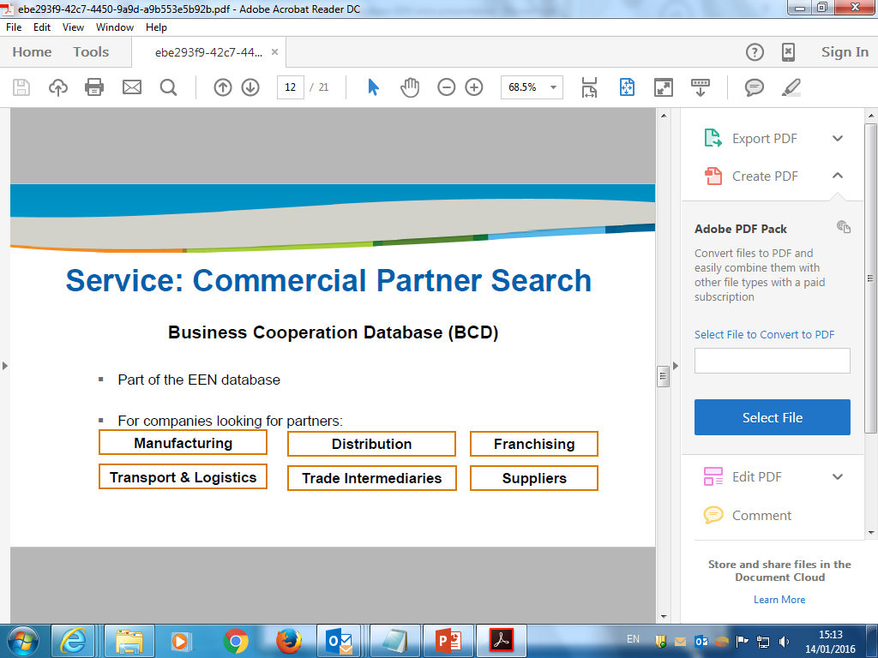
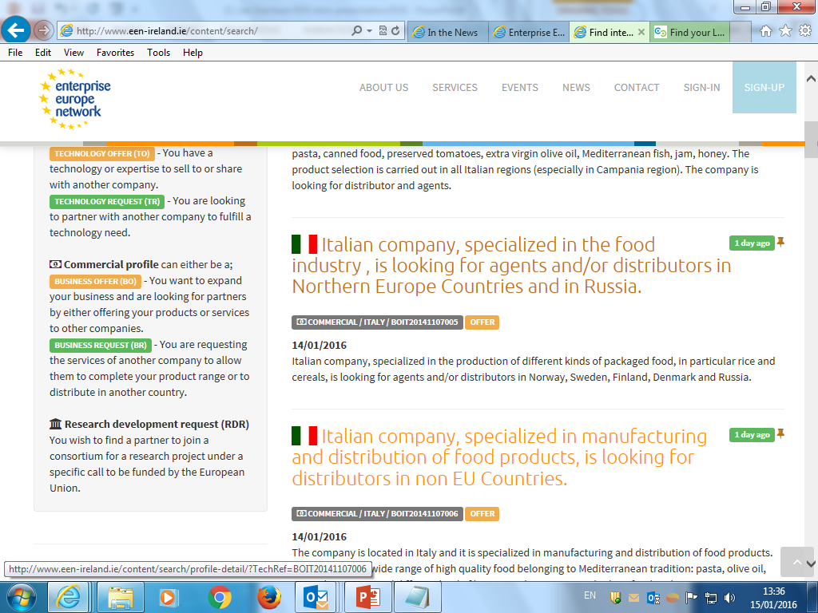
Business Partner Search
Search our database to find business partners to form the following partnerships
www.een-ireland.ie
Notes:
13
Just a little more detail on the variety of business solutions for you.
It could be (see headings above)

Slide 14
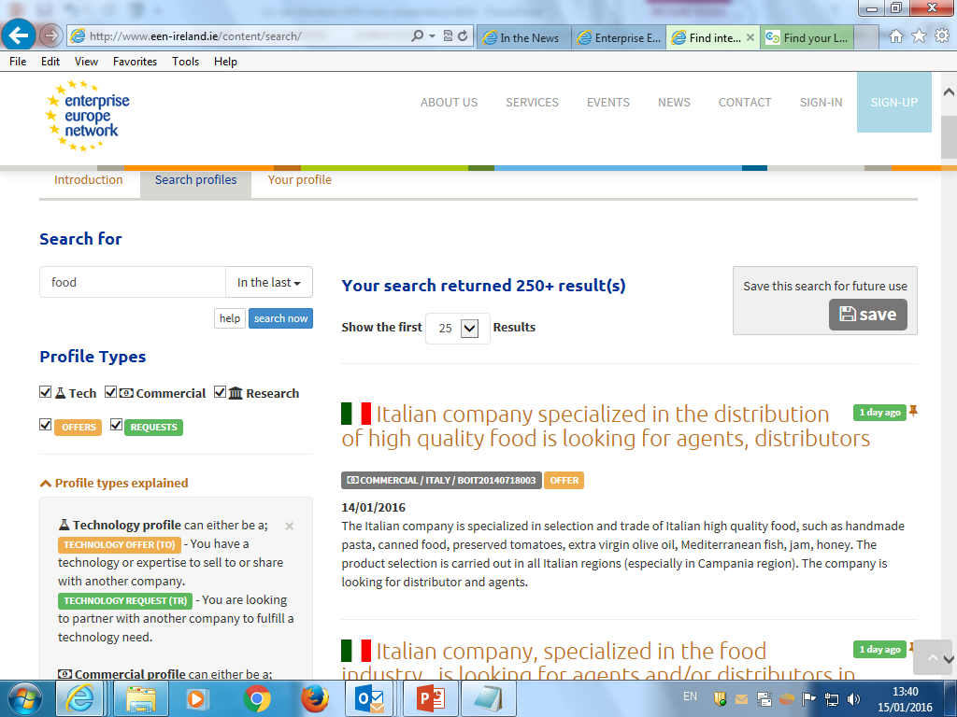
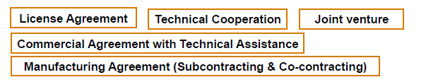


Technology Partner Search
Search our database to find technology partners
Type of technology agreements
www.een-ireland.ie
Notes:
14
Same again for technology partnering.
Expand on the EEN process and the importance of a comprehensive representation of your technology and expectation.
The profile is written in the third party, so it should be able to be comprehended by a third party, meaning that it should be descriptive and understandable.

Slide 15
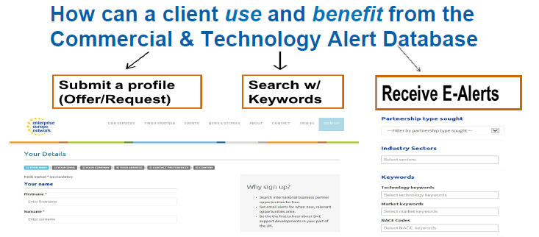
www.een-ireland.ie
Notes:
15
Expand on above.
The website facilitates you to receive email alerts based on your needs as described by your keyword input (search criteria).

Slide 16

EEN Role H2020
Innovation Management Assessment by EEN Experts
Selection of EU Approved Coaches with SME
Programming 3 Days for Phase I + 12 Days for Phase II
Overseeing Coaching progress + result
FREE Coaching Support
EEN Key Account Management
www.een-ireland.ie
Notes:
The EEN network has a further input into the H2020 (Horizon2020) programme, by facilitating coaching for innovation enhancement.
EXPAND ON THIS: Disruptive Technology with at least European if not Worldwide application. SME Instrument Phase 1 & 2. Procedures etc. Phase 1 €50k award and three days coaching, Phase 2 up to €3m and twelve days coaching.

Slide 17
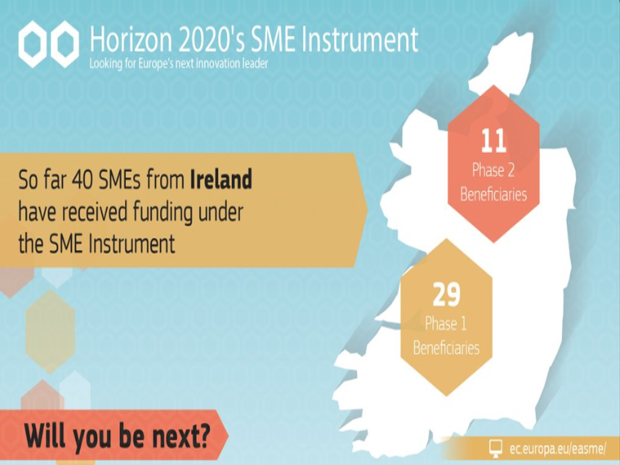
SME Instrument Success in Ireland
www.een-ireland.ie
Notes:
17
Ireland has been fairly successful to date with 40 SME’s receiving funding.
11 of these have been successful in gaining phase two funding.
Some of the successful companies in phase one have not applied for phase two.
Pro-rata one of the highest in Europe.

Slide 18
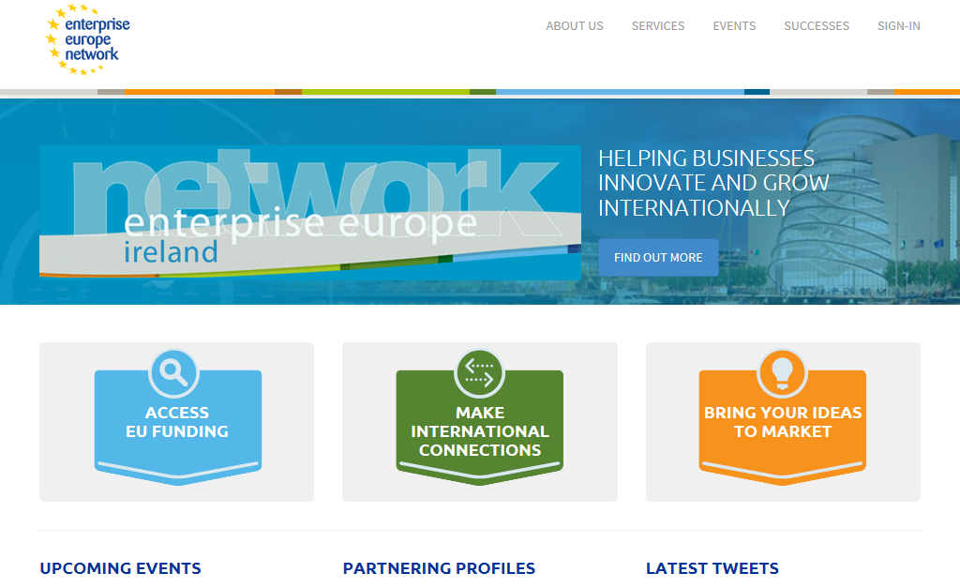
www.een-ireland.ie
Notes:
This is a screenshot of our website and we invite you to connect to it to find out what supports are available to you.
Play around with it and see what is in it for you.

Slide 19
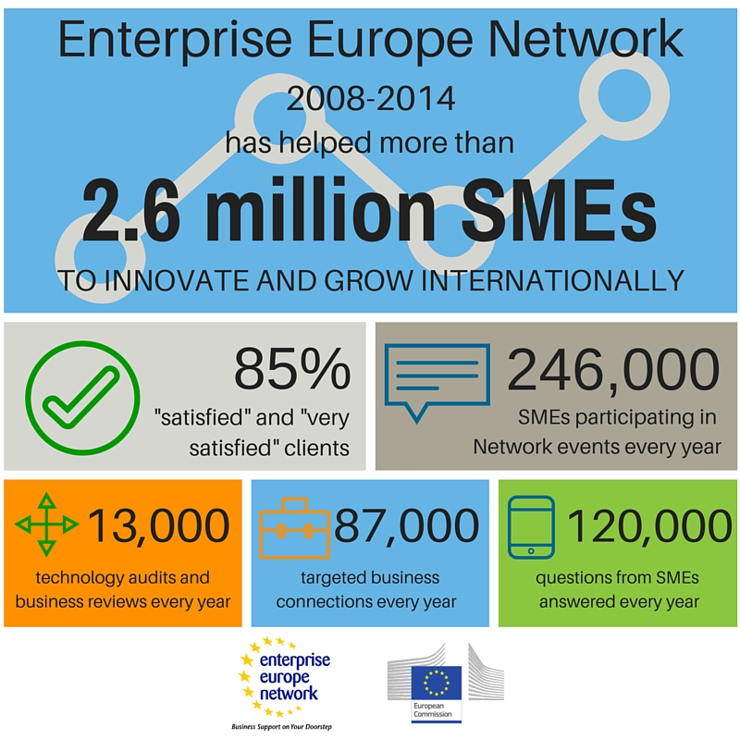
EEN - Bringing success to 2.6 million SMEs
Notes:
19
To Date:
The Network provided support to more than 2.6 million SMEs.
The Network has proved itself to be a gateway to international partnerships.
More than 1.7 million SMEs attended our events, To learn, To network and To do business.

Slide 20

Main Points to take away
Services designed for SME’s but available to all businesses, research centres, universities and Business Support Organisations
Does not fund any projects but assist in finding funding programmes and sources for finance
Unique in terms of geographical reach and range of services provided. Up to 10,000 live Business and Technology Opportunities!!!
SERVICES ARE FREE OF CHARGE
www.een-ireland.ie
Notes:
ALSO: When you consider R&D, think also of Technology Transfer.
They are both the two sides of the same coin and can compliment each other.
Also search to see if you are infringing someone’s patent.

Slide 21
Who can use EEN services?
Small and Medium Enterprises
Business Start-ups
Entrepreneurs
Research Centres
Universities & Institutes of Technology
Business Support Organisations
Industry Clusters
www.een-ireland.ie
THANK YOU!
Notes:
21

Slide 22
Contacts
Enterprise Ireland - Tel: 01 7272587
Cork Chamber of Commerce - Tel: 021 4509044
Dublin Chamber of Commerce - Tel: 01 644 7200
Your Local Enterprise Office - Tel:
Offaly 057 935 7480
Laois 057 866 1800
www.een-ireland.ie
Notes:
Contact details of your nearest Local Enterprise Office can be found on the EEN website.

