Slide 1


Slide 2



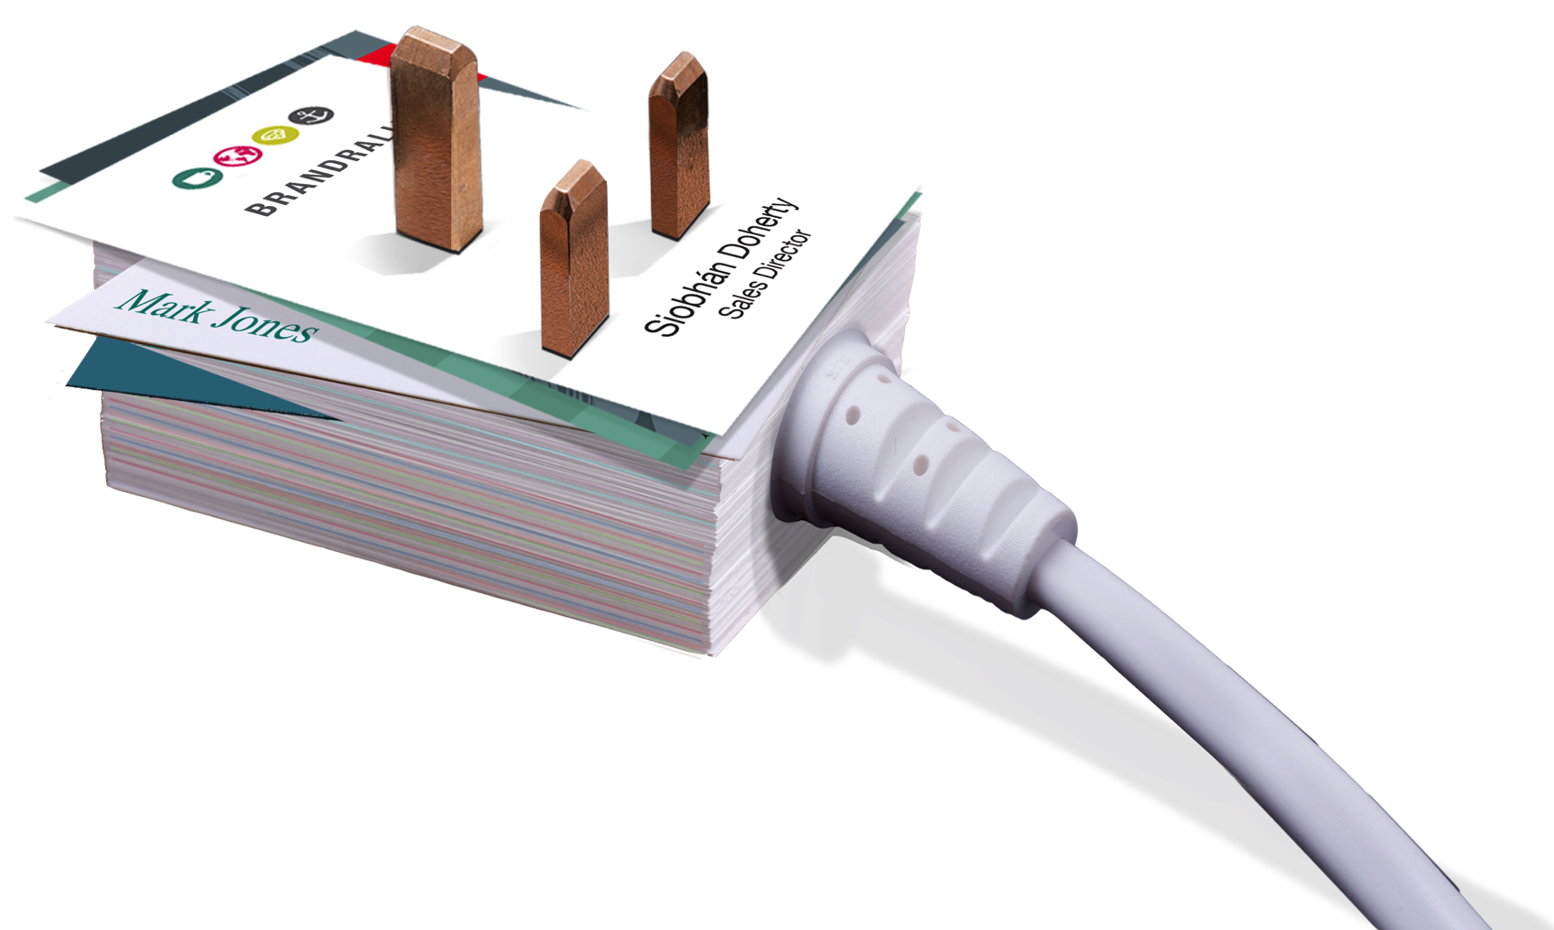
Discover What’s Possible
Intelligence Research Reports, Trade Statistics,
Business Monitor, Market Knowledge,
Academic & Graduate Knowledge and
Expertise
Funding Sales Growth, Innovation, Research,
Specialist Expertise
Contacts Conferences, Workshops, Seminars,
Masterclasses

Slide 3
North South Economic Co-operation
Funded by Both Governments
Supporting SME’s
Focus on Trade and Innovation
25,000 Companies assisted
6,000 Companies in programmes
3,000 Jobs created

Slide 4
Importance of Cross Border Trade
£2 billion/€2.8 billion annually
Export Destination
The Cross-border market is the first export market for 74% of business

Slide 5
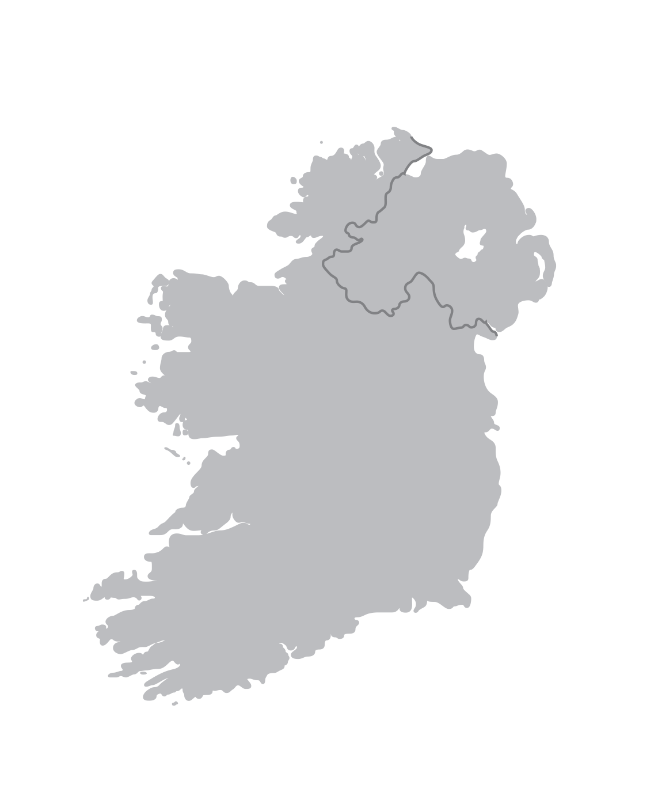
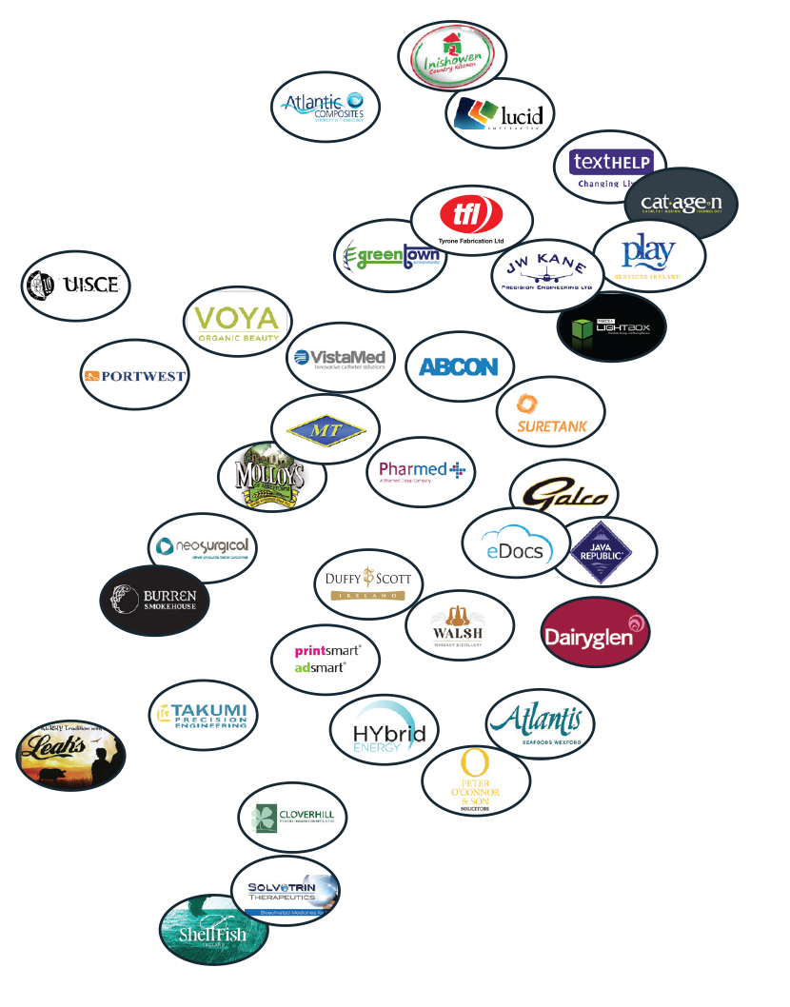
See How We Can Help
Join the many business that have benefited from our range of services

Slide 6
Range of Services

Slide 7


Slide 8


Sales Growth On Your Doorstep
Acumen
Assistance to source and fund the right person to help develop your cross-border sales.
Elevate
Bespoke consultancy for your business to help you develop a winning sales plan. Designed especially for micro businesses.
Trade Accelerator Voucher
Financial support for professional cross-border advice.
Simple Guide to Cross-Border Business
Free guide available to download from our website.

Slide 9


Slide 10


The Key to Innovation Success
FUSION
Funding for collaborative innovation partnership with an Academic and a Graduate.
Challenge
Innovation process to help bring ideas to market quicker and cheaper.
Horizon 2020
Help to access €80bn European research funding.
All-Island Innovation Programme
Innovation lectures, masterclasses and annual conference.

Slide 11


Slide 12


Succeed In Raising Finance
Funding Advisory Services
Funding advice for Early Stage Companies and Established Businesses.
Seedcorn Competition
With a total cash prize of €280,000 - the Seedcorn process helps Early
Stage Companies become investor ready.
Business Angel Funding
Access to the key Angel Investors and Syndicates across the Island.

Slide 13


Slide 14


Know-How to Tender Successfully
Meet the Buyer Events
Unique face-to-face access to key public sector buyers
Go-2-Tender
Tendering skills workshops for beginners and for SMEs that have already had some success in tendering but want to further refine their skills.
Consortia Facilitator
Helping businesses source tender partners and collaborative opportunities
Information and Advice
FAQs, tender guides, tender App, videos and
presentations

Slide 15


Slide 16


Improve Your Business Intelligence
Business Monitor
Inform your thinking with the largest all-island business owner-manager business confidence survey.
Research Reports
Extensive library of detailed research reports on key business topics.
Trade Statistics
Interact with our unique cross-border trade statistics web tool.

Slide 17


