Slide 1
Winning Public Sector Contracts
12th June 2015
City Hall
Peter McCarrick, Procurement Officer, Sligo Co.Council
Notes:
This presentation is designed to provide an overview of how small to medium businesses can win public sector contracts. It is recommended that you consult with your Local Enterprise Office or Local Authority for advice on participating in procurement processes.

Slide 2
Outline
Why work with the public sector?
How is public procurement structured?
What are the thresholds?
What opportunities are there in 2015?
Where are tenders advertised?
How are tenders received evaluated?
What supports are available for small businesses?
Notes:
The key items that this presentation addresses are:
Why work with the public sector? In short the public sector spends a considerable amount of money on a wide range of goods and services. But there are also a number of reasons for tendering for public sector contracts that make good business sense.
How is public procurement structured? Public procurement is thought to be very bureaucratic. But there are good reasons; it is to give all businesses a fair chance to win contracts and to deliver value for money for the tax payer. This presentation should help you to understand the concepts that underpin the public procurement process.
What are the thresholds and what do they mean? The threshold is the amount of spend that will dictate the complexity of the procurement. For smaller contracts or services, it should be straight forward. Larger contracts will need a more complicated procurement process.
A target schedule of contracts and frameworks for 2015 was published by the OGP in December 2014.
Once you decide to pursue public sector contracts you need to know where they are advertised.
Finally, this presentation will guide you towards the supports that are available to help your business to win public sector business.

Slide 3
Why work with the public sector?
Notes:
So what are the opportunities in the public sector? How much does the public sector spend? What goods and services are purchased?

Slide 4
Did you know?
The public service will spend around €8.5 billion on goods & services every year
    that's roughly €23.5m every day
This doesn’t include capital expenditure
Notes:
In Ireland, the public sector spends around €8.5million¹ on goods and services every year. That is €23.5million every day. This is a considerable market opportunity by any standards. This does not include capital expenditure, which as the tide turns on government finances is set to grow.
The public sector buys a very wide range of goods and services. Examples: plumbing services, carpenters, fuel, legal advisors, architects, laboratory equipment and supplies, stationary, ICT, janitorial services and equipment, hospital equipment, cleaning services, building contractors. The list is exhaustive.
¹Office of Government Procurement

Slide 5
Organising The Public Service
Multiple public bodies buying similar goods and services
Speak with ‘One Voice’
Value for Money for the tax payer
Establishment of the Office of Government Procurement
All public service procurement
Notes:
Up to now, all public bodies purchased their own goods and services. There was considerable duplication of effort. In 2012 the Government decided that the public service should go to the market with ‘one voice’. The view was taken that with better data we should get a better deal for the tax payer. To deliver this, the Government established the Office of Government Procurement to oversee all procurement in the public service. The multitude of purchasing was then categorised as set out in the next slide.

Slide 6

OGP Led Categories
Sector Led Categories
Professional Services
Facilities Management and Maintenance
Utilities
ICT and Office Equipment
Marketing, Print and Stationery
Travel and HR Services
Fleet and Plant
Managed Services
Local Government
  Minor Building Works & Civils
  Plant Hire
Health
  Medical Professional Services
  Medical and Diagnostic Equipment and Supplies
  Medical, Surgical and Pharmaceutical Supplies
Defence
  Defence and Security
Education
  Veterinary and Agriculture
  Laboratory, Diagnostics and Equipment
Notes:
All public sector expenditure is grouped into 16 categories. Some examples of what falls into the different categories:
Minor Building Works & Civils: Building, Electrical, Materials, Mechanical, Road
Plant Hire: Plant/Equipment Hire (including Driver/Operator)
Professional Services: Banking, Audit, Information Technology, Legal, Quantity Surveying
Facilities Management and Maintenance: Building Maintenance, Catering Services, Cleaning Services & Supplies, Uniforms, Waste Management
Utilities: Electricity, Gas, Fuels
ICT & Office Equipment: Hardware, Software, Services, Telecoms
Marketing, Print and Stationary: Advertising, Office Supplies, Promotional Events
Fleet and Plant: Equipment, Maintenance, Fleet Hire
Participating in the procurement process can help you to win business within one of these categories.

Slide 7
Advantages of winning a public sector contract:
Income stream
Continuous demand
Prompt payment
Business improvement
Local/regional
Source: Are tenders on your Radar?
Notes:
In addition to the considerable market of c. €8.5billion, there are other advantages of working with the public sector.
There is continuous demand. While in recent years public expenditure diminished, it did not completely disappear. There will always be a demand for public services.
There are opportunities to participate in local or regional mini-competitions to provide goods or services in your vicinity.
Public services are obliged to pay promptly, with a target to make payments within 15 days.
Participating in public procurement processes may lead to business improvement because you will have the systems in place to comply with the public sector requirements.

Slide 8
How is public procurement structured?
Notes:
Public procurement is often accused of being bureaucratic. In the next few slides we want to provide some of the thinking behind the procedures that are in place to help explain the purpose of the bureaucracy. In addition, we will set out the thresholds of expenditure to which the various levels of bureaucracy apply.

Slide 9
Principles guiding Public Procurement
Non-discrimination
Equal treatment of tenderers
Transparency
Proportionality
Mutual Recognition
Notes:
The public sector must apply certain principles when buying goods and services.
Transparency: The reason tenders are advertised, there is a standstill notice and a notice of award. Tenderers are also entitled to feedback. This is designed to help both the tax payer understand what the public service is spending their money on, and helps business to understand why they won or lost a tender, helping them improve for the next round.
Mutual Recognition: Equal validity must be given to the qualifications and standards of other EU member states.
Equal treatment of tenderers: The systems of advertising the contracts, the contract award and procurement processes all help to ensure that the public sector acts with integrity and is accountable for how public money is spent.
Non-discrimination: One example of this is the freedom of movement of people, goods and services across the EU. While it means that businesses in other European countries can bid for Irish contracts, it also means that Irish businesses can bid for contracts in other EU States. Enterprise Ireland provides supports to businesses who want to bid for contracts in the rest of the EU.
Proportionality: The requirements of the contract should be suitable for the particular contract (e.g. turnover levels, insurance requirements).

Slide 10
Legal Background
European Treaties
European Directives
National Rules & Guidelines
Common Law
Local Guidelines & Circulars
Notes:
To ensure that these principles are compiled with, a range of EU and national laws, regulations and guidelines govern procurement. Public bodies must comply with these regulations and non-compliance can lead to costly court cases. The current EU directives are the 2004 Public Sector Directive and the 2004 Utilities Directive. However, these EU directives are being updated and in 2014 the EU published a series of revised directives for public procurement. It is anticipated that these will be in Irish law by 2016. It is important to note that local authorities may put in place their own procedures, once they are in accordance with national and EU law.

Slide 11
New Directives
Already A Government Policy
Not yet law – but policy
Aimed at supporting SMEs
  Smaller lots
  Consortium or joint bids
  Greater use of open tendering
  Reduced turnover requirements
  Support innovation
Notes:
Even though the 2014 EU directives are not yet law in Ireland, the key elements of the directives aimed at supporting small and medium business have been adopted by the Government. Contracts can be divided into smaller lots or divided on a geographic basis. Consortiums, where business submit joint bids, are allowed¹. There should be greater use of open procedures. The turnover requirement has been reduced to twice the size of the contract, and public sector buyers are asked, where possible, to support innovation. These policies should make it easier for SMEs to win public sector contracts.
¹ The Competition and Consumer Protection Commission published a guide for SMEs called ‘How to comply with competition law when tendering as part of a consortium’ in December 2014.

Slide 12
Thresholds
Less than €25,000:
  Quotations requested
  Subject to local guidelines
€25,000 + to the EU Thresholds (€50,000 for Works)
  Advertise on eTenders
Notes:
There are clear guidelines by which public bodies must comply with in relation to advertising opportunities to businesses. Where contracts are greater than €25,000, or in the case of works greater than €50,000 then the contract must be advertised on eTenders.ie. Upcoming opportunities are sometimes noted on Procurement.ie. Below these thresholds quotations should sought, subject to local guidelines. These thresholds are most relevant to SMEs.

Slide 13
EU Thresholds
Advertise in OJEU
Public Body | Works | Supplies Services
Central Government | €5,186,000 | €134,000
Non-Central Government | €5,186,000 | €207,000
Utilities | €5,186,000 | €414,000
Notes:
For larger contracts Public Bodies must also advertise on the Official Journal of European Union. The thresholds are larger for works than they are for supply of services due to the nature of works.

Slide 14
What is a Framework?
An arrangement with suppliers
Supply goods, services and works
Agreed conditions
Specified period of time – max. 4 years
Single supplier framework
Multiple supplier framework
Notes:
Frameworks are increasingly being used by public bodies to procure goods and services. Frameworks are arrangements between public bodies and suppliers to supply goods, services and works under agreed conditions for a period of time – normally not more than four years.
There are two types of frameworks:
Single Supplier Framework
Multiple Supplier Framework – minimum of 3
Awarded based on original tenders
Mini-competitions conducted

Slide 15
Tendering Procedures
Open
  Single stage procedure
Restricted
  Two stage process
  Those who meet minimum requirements invited to tender.
  Minimum Number Invited to Tender (5)
Competitive Dialogue – Very Rare
  Very complex requirements/specialist
  Provides more flexibility in the process
Negotiated – Very Rare
  RFT issued and responses form basis of negotiation
Notes:
There are four types of procedure: open, restricted, competitive dialogue and negotiated. Open Procedure occurs when all relevant businesses can submit a tender. Under the Restricted Procedure businesses must pre-qualify before they are invited to tender. Both Competitive Dialogue and Negotiated are usually for more complicated large contracts and are rarely used.

Slide 16
Opportunities in 2015
Notes:
If you are interested in tendering for a public service contract the following slides give information on the scope of opportunities available.

Slide 17
OGP Pipeline
Category | Q1 | Q2 | Q3 | Q4
Professional Services | Architectural Services (Local Government) | Financial & Economic Consultancy Services | Solicitors (Local Government) Legal Services (ETBs) Advisory Consultancy Services | Architectural, Quantity Surveying and Engineering Services Solicitors Advisory Consultancy Services
Facilities Management | Uniforms | Cleaning Products & Equipment Catering Security Services Uniforms Footwear | Cleaning Products & Services Waste Pest Control Standard PPE | Cleaning Products Laundry Services Waste Document Management Lift Maintenance Fire Alarm Services Boiler Maintenance
Notes:
This and the next two slides show the OGP’s target schedule of contracts and frameworks for 2015. This was published on www.procurement.ie in December 2014. As can be seen a broad range of goods and services will be required.
This slide details the pipeline for the Professional Services and Facilities Management Categories.

Slide 18
OGP Pipeline Continued
Category | Q1 | Q2 | Q3 | Q4
Utilities | Electricity Natural Gas Gas Mini Competition | Electricity Mini Competition Gas Mini Competition | Energy Advisory Contract Electricity Mini Competition Gas Mini Competition | Electricity Mini Competition Electricity Mini Competition Gas Mini Competition Fuels Advisor
ICT | ICT Research Advisory CRM | Application Licencing Solutions ERP Solutions Telecoms (Lease Line) Wide Area Network VOIP Network Equipment | Enterprise Virtualisation Mailroom Equipment Enterprise Backup Local Area networks PCs, Notebooks, Tablets, Thin Clients ICT Professional Services | Desktop Software Security monitoring and analysis software Mobile Services Computer Peripherals
Notes:
The Utilities and ICT Category pipelines are shown on this slide.

Slide 19
OGP Pipeline Continued
Category | Q1 | Q2 | Q3 | Q4
Marketing, Print & Stationery | Polling Information Cards | Beef Certificates Print Shared Services | Promotional Events Framework General Print Framework Advertising Media Buying Framework | Envelope Contract Secure Print Frameworks Advertising Creative Media Frameworks
Travel, Transport & HR Services | Taxis (Dublin) Towing Services Garda FOI Training | Travel Insurance | Towing Services Employee Assistance Services Health & Safety Training | Courier / Pouched Mail Cash in Transit Car Hire Staff Learning & Development Selected Bus Services
Fleet & Plant |  |  | New Fleet Framework | Plant Framework
Managed Services | Shuttle Bus HSE Galway | Translation & Interpretation Services |  | Business Support Services
Notes:
The pipeline for Marketing, Print and Stationary; Travel, Transport and HR Services; Fleet and Plant; and Managed Services are outlined in the table onscreen.

Slide 20
Local Government Pipeline
Q1 | Q2 | Q3 | Q4
Fuels (LA) | Energy Retrofit (LA) | Asbestos (LA) | Bitumen 2016 (LA)
 | Deep Energy Retrofit (LA) | Asbestos (OPW) | Plant Hire 2016 (LA)
 | Voids (LA) | Asbestos (Dept. of Education) | Building Works (HSE Non Acute)
 | Plumbing Services (LA) | Temporary Accommodation (LA) | Building Works (HSE - Acute)
 | Electricial Services (LA) | Building Refurbishment (OPW) | Mechanical Services (HSE - Acute)
 | Asbestos (HSE) | Pavement Management Survey (LA) | Mechanical Services (HSE - Non Acute)
 | Temporary Accomodation (Dept. of Education) |  | Electrical Services (HSE - Acute)
 |  |  | Electrical Services (HSE -Non Acute)
Notes:
In 2015 the Local Government Operational Procurement Centre intend to run a number of competitions on behalf of local authorities and other public sector bodies. These competitions will be related to the Minor Building Works & Civils and Plant Hire categories.

Slide 21
Where are tenders advertised?

Slide 22
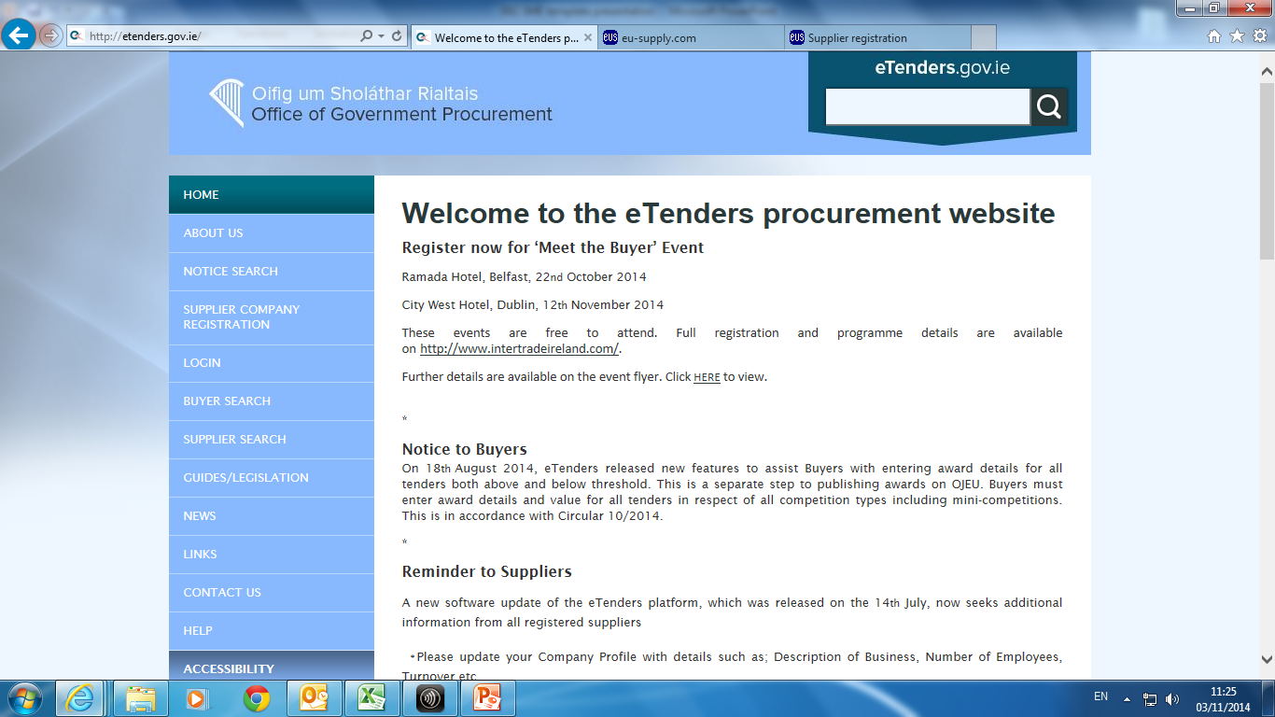
Where are tenders advertised?
www.etenders.gov.ie
Notes:
E-tenders.gov.ie:
Published tenders & published awards can be seen via the ‘Notice Search’ on the left of the screen
If you register on the site you can receive notifications when tenders in your categories of interest are advertised

Slide 23
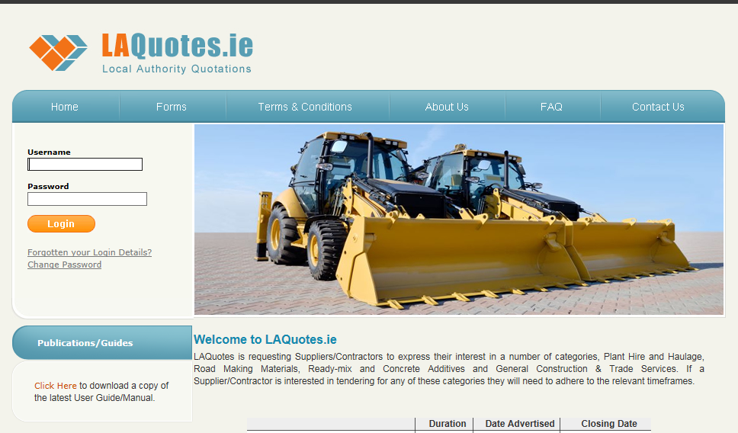
Where are tenders advertised?
www.laquotes.ie
Notes:
LAQuotes:
Local authority system used for quotations, frameworks and mini-competitions.
All tenders and frameworks are advertised on www.etenders.gov.ie but some Contractors/Suppliers may be asked to submit some or all of their information via www.LAQuotes.ie where details are collated.
This is relevant to the Plant Hire and Minor Building Works & Civils categories.

Slide 24
The Process – Should You Tender?

Slide 25
Tips for Responding to Tenders
Read the request for tender carefully
Decide if the tender is suitable for your company
Answer all the questions
Pay attention to the weightings attached to the selection & award criteria
Include all the required documentation
Submit your application by the closing date
Notes:
Make sure to read the request for tender carefully it contains very valuable information and details of the requirements of the contracting authority.
Decide if the tender is suitable for your company. Do you have the capacity and skills required to fulfil the obligations of the contract?
Make sure to answer all the questions. In the interest of fairness incomplete submissions may be excluded.
Pay particular attention to the weightings. This is the basis by which the public body will make its decision.
Make sure to include all the requested documents.
Submit your application by the closing date. Again, in the interest of fairness late applications cannot be accepted.

Slide 26

Evaluation Process
Award
Selection
Compliance
Notes:
There are three stages of evaluation. Tenderers have to pass every previous stage in order to be evaluated in the next stage
Stage of preliminary examination – Compliance
Stage of evaluation of qualification criteria – Selection
Stage of evaluation of tenders for the award of the contract – Award
The next slides provide an overview of each of these stages.

Slide 27
Evaluation Process - Compliance
Tenders are checked to ensure they have complied with the instructions given in the ITT
Missing documents, blank documents, unsigned documents etc.
Clarifications
Notes:
Tenders are firstly evaluated for compliance. Tenders are assessed to see if the documentation they provided is compliant and all required documents are included and fully completed.

Slide 28
Evaluation Process - Selection
The selection criteria permitted are:
    Economic and financial standing
    Professional and technical knowledge or ability
    Quality assurance standards
    Environmental management standards
    Objective non-discriminatory short-listing criteria
Only tenderers qualified in accordance with selection criteria will proceed to be evaluated under award criteria
Notes:
Selection is carefully undertaken. Selection criteria permitted includes;
Economic and financial standing of the company.
Professional and technical ability to fulfil the contract.
Quality assurance and environmental management standards
Clearly stated non discriminatory short-listing criteria
Importantly, only tenderers who have qualified in accordance with the selection criteria will proceed to be evaluated under award criteria.

Slide 29
Evaluation Process - Award
Lowest Price or MEAT
MEAT - Most Economically Advantageous Tender
      Price
      Quality
      Technical merit
      Environmental characteristic
      Service & technical assistance
      Delivery terms
Weighting criteria for MEAT must be clear
Abnormally low tenders
Notes:
At award stage, tenders are evaluated according to either lowest price criteria or what is called MEAT criteria. Lowest price is straight forward, but may not reflect the requirements of the public body. MEAT stands for Most Economically Advantageous Tender. Where MEAT criteria is used, the criteria must be clearly stated. These would typically include: price, quality, technical merit, environmental characteristics, services and technical assistance and delivery terms. Weighting criteria for MEAT must be clearly stated.
Where tenders received are considered abnormally low this may raise questions about the reliability of the service being offered. If tenders are abnormally low then a public body must ask why. In the interest of fairness, prices are assessed using formulae and the lowest tender will generally get full marks. An evaluation report will be prepared.

Slide 30
What’s a Standstill Period
The standstill notice must give sufficient information to enable an unsuccessful bidder to decide whether there are grounds for seeking a review
Standstill Period (OJEU contracts)
      14 calendar days – standstill notice sent by fax or email
      16 calendar days – standstill notice sent by other means
      Standstill period commences day following publication of a valid standstill notice to unsuccessful Tenderers
During the Standstill Period
      Contracts Cannot be Concluded
      The Contracting Authority Cannot Negotiate Contract Terms
      The Contracting Authority Cannot Allow Work to Commence
Notes:
A standstill period allows unsuccessful tenderers decide whether there are grounds for seeking review. For contracts advertised in the Official Journal of the European Union the standstill period is 14 days if the notice is sent by email, 16 days if sent by other means. The period starts the day following publication of a valid standstill notice to unsuccessful tenderers. The public body cannot proceed with the contracts or works, nor can they negotiate terms during a standstill period.
A contracting body may use a shorter voluntary standstill period for lower value contracts. The contracting body will be able to advise on this.

Slide 31
Unsuccessful – Feedback is Available
Available on request
  Reasons for elimination
  The name of the successful tenderer
Not entitled to details of others tenders (including prices)
Notices of Contract Awards
Notes:
If you do not succeed then you are entitled to feedback. This is available on request and should present the reason for elimination and the name of the successful tenderer. That said, you are not entitled to commercially sensitive information such as the price.
Notices of Contract Awards must be published for contracts subject to European directives. These can include information around ‘price or ranges of prices paid’ and the ‘value of winning awards or the highest and lowest offer taken into account in the award of the contract’

Slide 32
What Supports are Available to small business?

Slide 33
Support
Additional support and training available:
  Local Enterprise Office
  Enterprise Ireland
  Intertrade Ireland
Notes:
It is acknowledged that public procurement can be bureaucratic, with a number of specific requirements. But it can be well worth it. The payment terms are good and the experience can be valuable. Mentoring support may be available from your Local Enterprise Office, Enterprise Ireland or InterTrade Ireland. Your first point of contact is your Local Enterprise Office. They will point you in the right direction.

Slide 34
Tender Advisory Service
Operational from 1st February, 2015
Objective – Support SMEs
  Outlet to raise concerns in relation to a live tender process
Contact www.procurement.ie or tenderadvisoryservice@ogp.ie
Notes:
The Tender Advisory Service (TAS) is provided free of charge by the OGP to suppliers in order to raise concerns in relation to a live tender process carried out by any public sector contracting body (excluding commercial semi-states bodies).
TAS can only be used by suppliers with an interest in a specific tender process in the following circumstances:
• their enquiry is in respect of a Request for Tender (RFT) that has been published
• the supplier has a registered interest in the specific tender process
• the supplier has already availed of the clarification process set out in the Request for Tender (RFT) documentation but is not satisfied with the response received from the contracting authority
• the supplier has completed a Standard Enquiry Form and forwarded it, and accompanying documentation, to TAS at least 6 days prior to the tender closing date
If you would like more information on TAS or to avail of the service see www.procurement.ie or email tenderadvisoryservice@ogp.ie.

Slide 35
Best of Luck!

