Slide 1
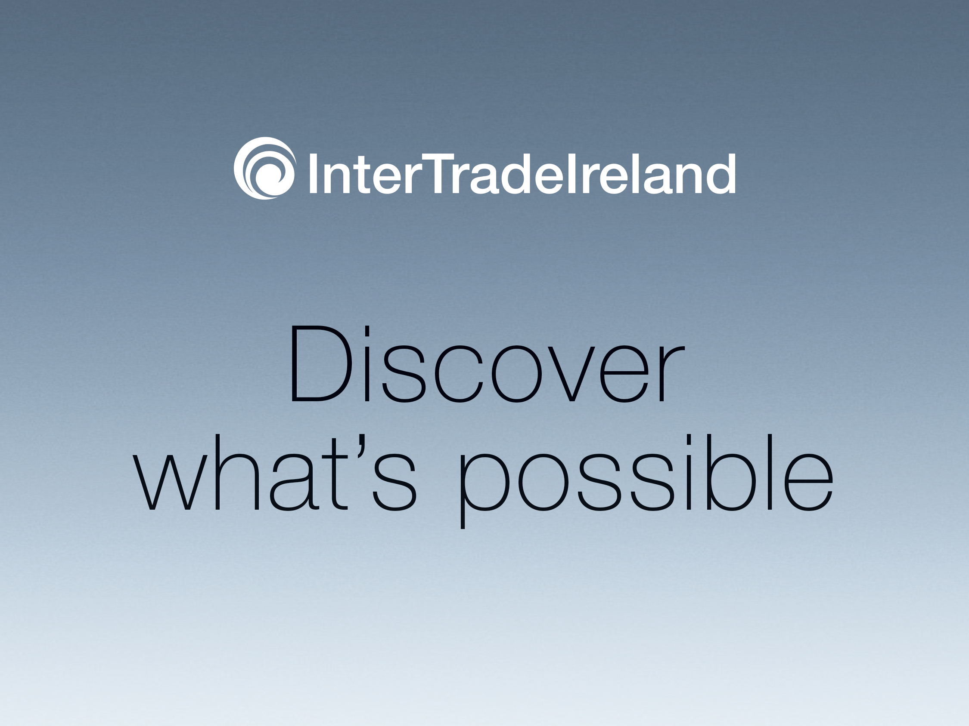

Slide 2

Energising
Business
A brief introduction to identifying, targeting and exploiting new sales opportunities in N Ireland.

Slide 3

Discover What’s Possible
Broad themes for this morning....
Where the real opportunities lie in Northern Ireland for Irish SMEs and micro enterprises.
What cultural similarities and differences you need to be aware of when seeking to do business in NI.
How to use NI as a stepping stone into the larger markets of England, Scotland and Wales.
How to tender for work with public sector customers in Northern Ireland.
How to access practical support to support your efforts to win new sales in Northern Ireland.

Slide 4
People, places, things....
What are your perceptions of N Ireland?
“The Troubles”
Titanic
Giant’s Causeway
Rory McIlroy
Shopping Trips
“Puke Football”© M Harte & P. Spillane 2003

Slide 5
Population
Population of 1.8 million people in NI – compared to 4.58 million in Republic of Ireland / 60 million in UK:
  Population of Munster: 1.25 million
  Population of Leinster: 2.5 million
  Population of Connacht: 550,000
  Population of Co Sligo: 67,000
Population sizes - cities:
  “Dublin City”: 530,000 (Greater Dublin 1.8 million).
  Belfast: 285,000.
  Cork: 120,000.
  Derry: 85,000
  Galway: 75,000
  Sligo: 20,000
BUT population of the Belfast Metropolitan Area – is 580,000 - 33% of the total NI population lives within 10 miles of Belfast City Centre.

Slide 6
Geography
Driving distances:
  Belfast – Dublin 1 hr 45 mins
  Sligo – Belfast 2 hrs 40 mins
  Sligo – Derry 2 hrs
  Sligo – Omagh 1 hr 45 mins
  Sligo – Waterford 4 hrs
  Sligo – Killarney 4hrs 25 mins
Driving distances within NI:
  2 hours from Belfast to Derry.
  45 minutes from Newry to Belfast.
  1 hr 45 mins hours from Belfast to Enniskillen
Road network good – NI dissected by:
  M1 East - West
  M2 North - South
  Dual carriageway between Newry and Belfast.
No toll roads in Northern Ireland…yet!!

Slide 7
Social Issues – The Positives
Free health service.
Good standard of education.
Significant growth in immigrant population in NI over the last 10 years.
National identity tends not to be a big issue in business.
NI much more cosmopolitan than 20 years ago.
Brain drain much less acute now due to:
  Recovering economic conditions.
  More peaceful environment.
  University Fees in England/Scotland – QUB €5,000 per year

Slide 8
Social Issues – The Negatives
  Significant cutbacks across the public sector ongoing – health / social services etc.
Health service under severe pressure.
Communities still divided in certain areas esp. urban working class
New “minorities”

Slide 9
The Economy
NI economy emerged from recession in June 2013 ...steady growth since then:
  Unemployment falling – now 6% (Dec 15 – Feb 15)
  Claimant Count 42,500 – has fallen for 27 months in a row.
  But immigration levels have risen over the last 10 years and this is creating tensions over “our jobs”.
  Consumer confidence rising – house prices at their highest levels since 2007 – Average house price in NI is €170,000, up 6.9% on the same period last year
  Significant FDI successes recently – NI has out-performed all other UK regions in this regard ...but corporation tax levels between NI and ROI a major bone of contention.
BUT remember that Northern Ireland contributed only 2% of the UK’s economic output during 2014.

Slide 10
The Economy
Average Weekly Wage in 2014 was €575 (€840 in RoI)
GDP 2014 - €38 billion – RoI €200 billion
GDP per capita ½ what RoI produces
GDP per capita RoI – 15th in world – NI approx. 58th
BUT remember that NI is predominantly a SME / micro enterprise economy – 70,000 VAT registered businesses (VAT threshold £82,000/€110,000)
Approx. 20,000 other “real” businesses
45% of all businesses have turnover of less than £100,000
9% have turnover of in excess of €1.25 mill
90% of all businesses are micro-businesses i.e. fewer than 10 employees

Slide 11
The Economy
The five largest industry groups in Northern Ireland accounted for almost two thirds (approx. 62%) of Northern Ireland businesses.
Agriculture, Forestry & Fishing 24%
Construction 14%
Retail 10%
Professional, Scientific & Technical 7%
Production 7%
Other sectors:
Accommodation & Food
Transport
Health
Arts & Entertainment

Slide 12
The Economy – The Big Players
Engineering:
  Terex.
  FG Wilson / Caterpillar.
  Bombardier Shorts.
  Wrightbus
  BE Aerospace.
Food:
  Moy Park.
  Irwin’s Bakery
  Dale Farm Dairy
Construction Products/Services:
  Lagan Group.
Pharmaceuticals / medical devices:
  Norbrook
  Almac
  Armstrong Medical.
  Randox.
Tradable Services:
  First Derivatives
  First Source Solutions
  All State.
Creative industries / digital sector
Recycling and renewables.

Slide 13
Politics
Since 1998, a devolved government has sat at Stormont – 108 MLAs sit in the Assembly in total representing 18 constituencies:
56 Unionists
42 Nationalists
9 Other
1 Speaker (SF)
The Northern Ireland Executive is the administrative arm of the NI Assembly. The Executive is a “mandatory coalition”, meaning that ministerial seats are allocated according to electoral strength. There is no formal opposition party. At present, seats are allocated as follows:
DUP 5
Sinn Fein 4
SDLP 1
UUP 1
Alliance: 2
Despite some flaws in the system, the influence of paramilitaries has reduced and politically motivated violence has dropped significantly. There will be Assembly elections in May 2016.

Slide 14
North – South - North
Of all goods purchased in N Ireland, 22% is produced in NI and 78% comes from outside
Of that 78% approx. 15% comes in from Republic of Ireland
Total Value of Goods going South – €2 billion (2103)
Total Value of Goods going North – €1.8 billion (2013)
In total RoI exports 13 times as much as NI

Slide 15
Barriers to Selling into NI
Concerns about exchange risk – Euro v Sterling.
Market is perceived by many in ROI as too small – not worth the hassle.
Statutory agencies in RoI don’t view NI as “export”
Historic/cultural/perception reasons
Residual fears about security/political instability.

Slide 16
Breaking Down The Barriers
Avoid stereotypes!
Since 1998 NI business/people have become more outward looking
Realisation that the answer to growing of the NI economy is to be found outside NI
Northern Ireland buyers – both private and public sector – are increasingly open to working with Southern suppliers (Dependent on Value for Money).
Business practices in the two jurisdictions broadly the same
People do business with people
NI customers are looking at solutions to problems and good feelings at a reasonable price

Slide 17
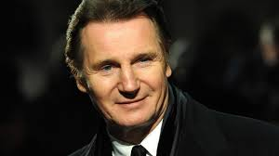

Breaking Down The Barriers
There is no single, homogeneous “Northern” type
Successful business people don’t let politics, religion and identity stand in the way of growing their business.

Slide 18
Taking The First Step
Why NI…??
Same language/same culture ...broadly speaking!!
Ideal starter “export” market – allows ROI SMEs to dip their toe in the exporting waters for the 1st time.
Can provide a stepping stone to the GB market.
Same island/ease of access.
Recovering economy in NI...with growing business confidence and a more outward looking population.

Slide 19
Public Sector Opportunities
The public sector has traditionally been hugely important in NI accounts for 28% of the total workforce .... but was 37% in 1992. 20,000 public sector jobs to go over 2015 – 2019. Target of under 25% by then
Much larger public sector in NI than in rest of UK - 19.5% average across England, Scotland and Wales.
In total, the British government subvention totalled £5,000m/or 20% of Northern Ireland's economic output last year.
The Northern Ireland public sector spends an estimated £1.6 billion each year on a wide range of goods services – 2,355 contracts awarded last year.

Slide 20
Public Sector Opportunities
18,900 tenders received
78% of all contracts were awarded to SMEs (up to 250 employees) and 19% of all contracts were awarded to micro businesses (up to ten employees)
79% of all contracts were awarded to suppliers based in Northern Ireland

Slide 21
Public Sector Opportunities
Threshold Guidelines
Up to £5,000 - Departments must demonstrate that value for money has been secured...but have discretionary purchasing authority.
£5,000 - £30,000 - A minimum of two tenders invited by the person authorised to procure for their organisations
£30,000 to EU Thresholds - Advertise on eSourcing (eTendersNI)
Above EU thresholds - Advertise on eSourcing Nl (eTendersNI) AND Official Journal of EU [OJEU]

Slide 22
Public Sector Opportunities
Central Government departments x 12
Agriculture
Education
Local Government
Others
Education authorities
Health Trusts
Social Security Agency
Single Education Authority
PSNI etc
Enterprise
Finance
Justice
Social Development
Culture
Employment and Learning
Environment
Health
Regional Development
1st and Deputy First Minister.
From 1st April 2015 there are now 11 local authorities in NI (down from 26).
Wider powers, now responsible for planning, economic development etc

Slide 23
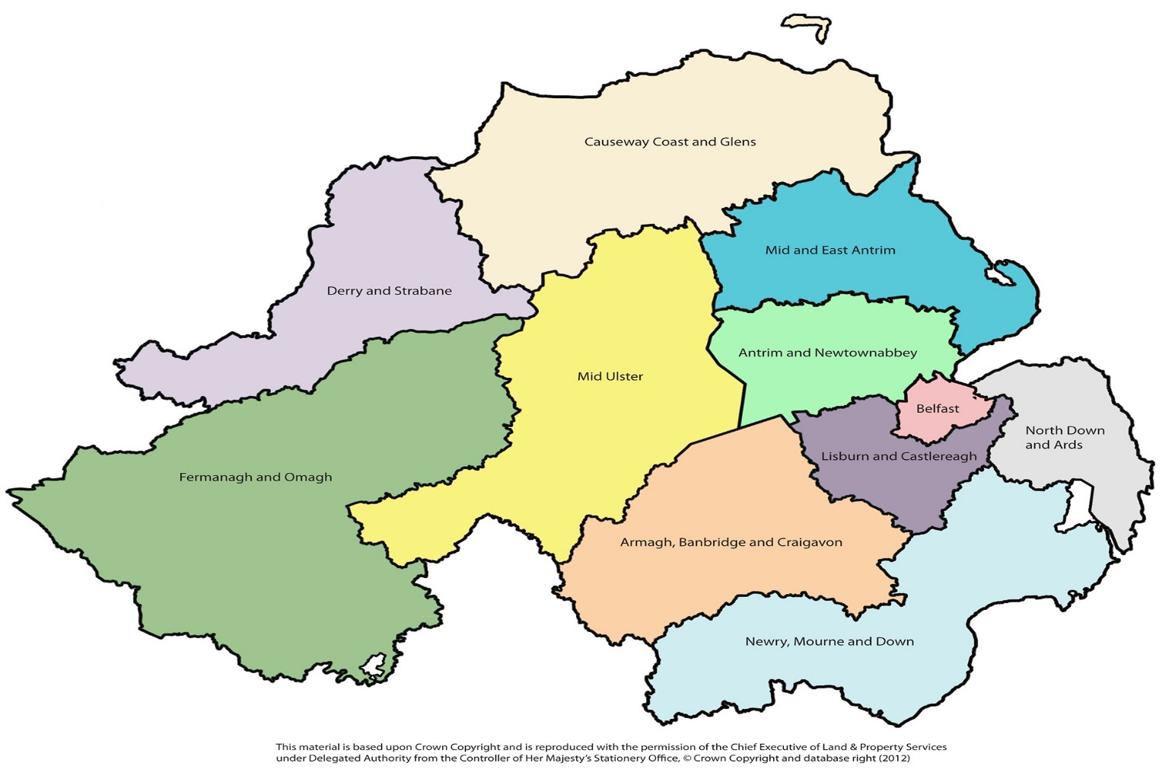
Local Government Reform

Slide 24
Public Sector Links
Central Procurement Directorate
http://www.dfpni.gov.uk/index/procurement-2/cpd.htm
E-Sourcing
https://e-sourcingni.bravosolution.co.uk/web/login.shtml
eTendersNI
https://etendersni.gov.uk/epps/home.do
New “Super” Councils
http://www.nidirect.gov.uk/local-councils-in-northern-ireland

Slide 25
Private Sector Opportunities
Elevate
Bespoke consultancy for your business to help you develop a winning sales plan. Designed especially for micro businesses. To take part in the Elevate programme - companies must:
Be a small company with less than 10 employees;
Be a manufacturing or tradeable service company with an annual turnover below €1.2m;
Have a satisfactory track record and a trading history in their home market (minimum of 18 mths);
Be focused on winning new cross-border sales;
Have not generated more than 30% of their total turnover in the target cross-border market;
Have the capacity (human, financial and production) to deliver the project;
Have a sufficiently unique product that does not displace existing products in the market place.
Have not previously participated on InterTradeIreland Acumen programme

Slide 26
Private Sector Opportunities
Acumen
Acumen offers three business support options:
Full Time Sales Person
Part Time Sales Person
Market Research
Benefits
Access to new markets and increased sales
Better knowledge of the cross-border market
New business opportunities identified
Improvements to your sales and marketing strategy
Increased business contacts and prospects across N Ireland

Slide 27
Private Sector Opportunities
Acumen
Am I eligible?
To qualify for financial support through our Acumen programme ideally your business should be:
A manufacturing or a tradable service company with an annual turnover below €50 million
A company that employs less than 250 people
An indigenous company (not multinational or foreign owned)
Committed to the development of new product markets with the potential of job creation
A company with an established relationship with a mainstream development agency (e.g. Enterprise Ireland, Údarás na Gaeltachta, a Local Enterprise Office)
In addition, you should also have:
A satisfactory track record in your home market
Less than 30% of total business in the target cross-border market already
A sufficiently unique product that does not displace existing products in the marketplace
A project that can demonstrate that it may not happen without support
The capacity (human, financial & production) to deliver the project

Slide 28
To Sum Up…
N Ireland provides an opportunity because:
  It’s a market that is on your doorstep.
  You can be there in less than 2 hours.
  Smaller than Connacht but 3 times the population.
  We speak the same language ...more or less!
  Business culture very similar
  Opportunity for less experienced “exporters”.
  Gateway to a market of 60 million people in GB.

Slide 29
Private Sector Opportunities
For further details:
Seamus McCann
048 6632 0443
+44 777 606 5004
Seamus.McCann@itiacumen.com

Slide 30


