Slide 1
Susan Hayes, CFA
Tweet me @SusanHayes_

Slide 4
REALITIES
I’m worried about my existing business
I don’t where to start
I’m concerned it might too expensive
I’m afraid what people might say if it doesn’t work out
GOAL:
I want to begin exporting profitably in 2016

Slide 6
REALITIES
I’m worried about my existing business
I don’t where to start
I’m concerned it might too expensive
I’m afraid what people might say if it doesn’t work out
OPPORTUNITIES
I can budget my time, effort and resources as well as use digital flexibility
I can look for trade missions, international networks, LinkedIn Groups, hashtags etc
I need to rethink my margins, identify what I can invest, seek funding and be savvy!
R
C
G
GOAL:
I want to begin exporting profitably in 2016
C
C
NC
O
W

Slide 7
GOAL:
I want to begin exporting profitably in 2016
What am I going to do about it?
1) I’m going to open a spreadsheet of all the new opportunities I can find
2) I’m going to approach all of these individuals and agencies
3) I’m going to approach the LEO some funding to plan a trip (including Eventbrite etc) to Manchester built around a conference of relevance

Slide 8
DON’T WAIT FOR THE PERFECT MOMENT
TAKE THE MOMENT AND MAKE IT PERFECT

Slide 9
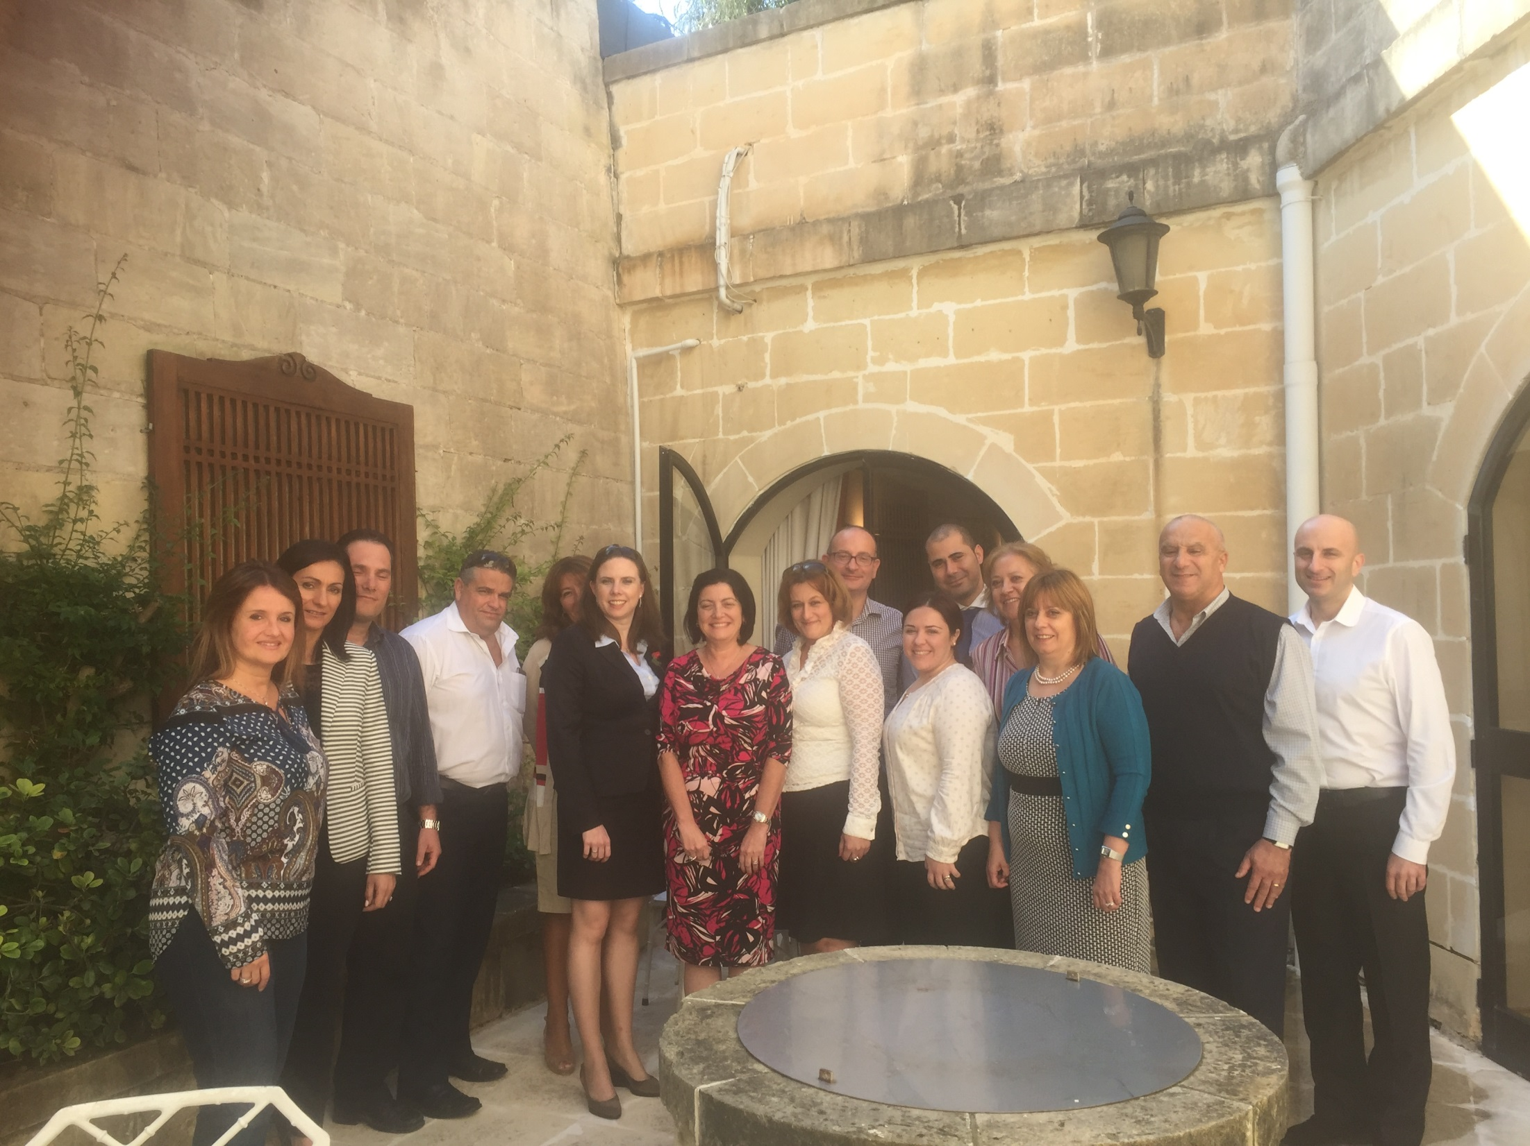

Slide 10
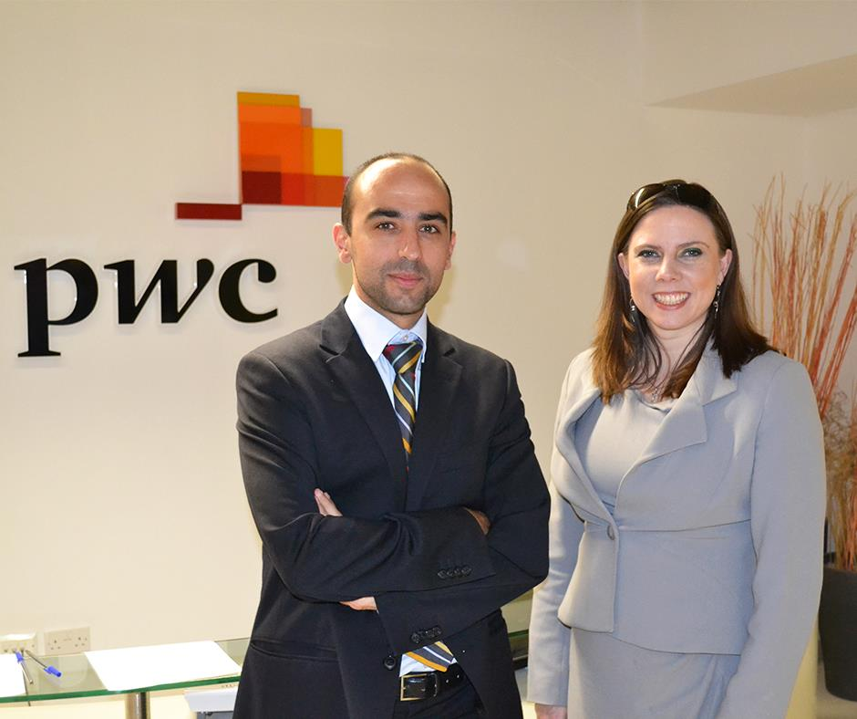

Slide 11
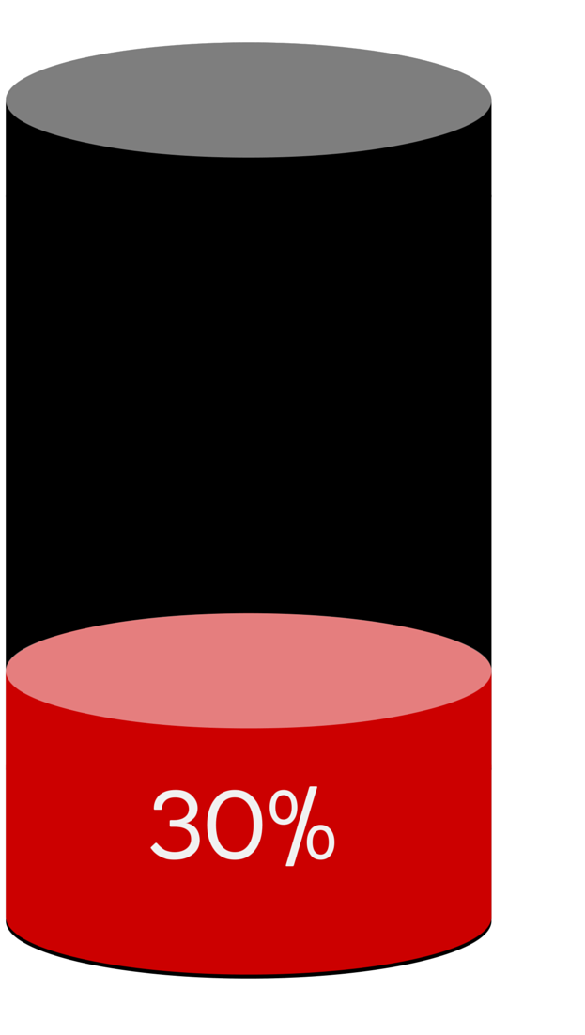
Action!
1 What could I do today?
2 What could I do by this day next month?
3 Who could I ask to hold me accountable?

Slide 12
“By going after what you truly want, you empower others to follow in your footsteps”
Susan HayesCulleton
Tweet me at @SusanHayes_

